Slide 1
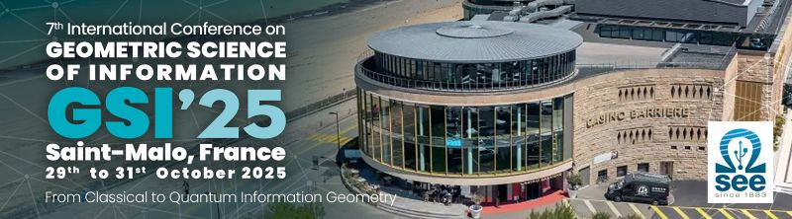
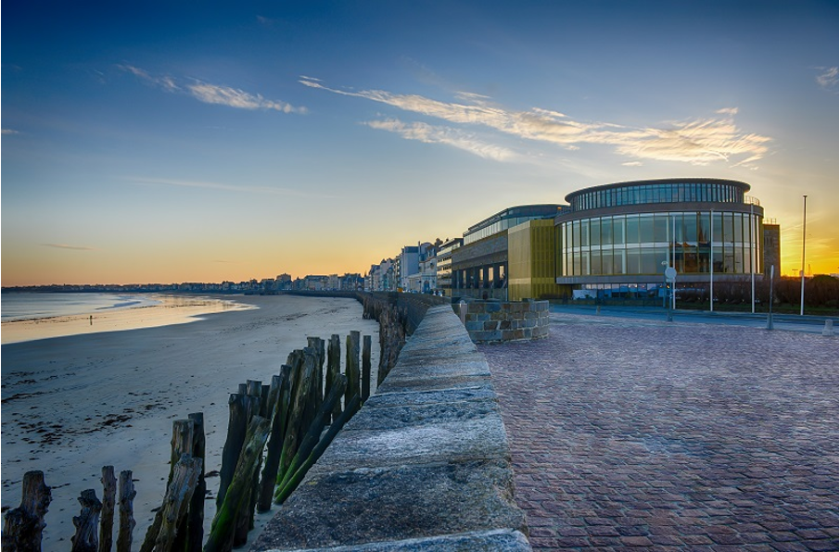
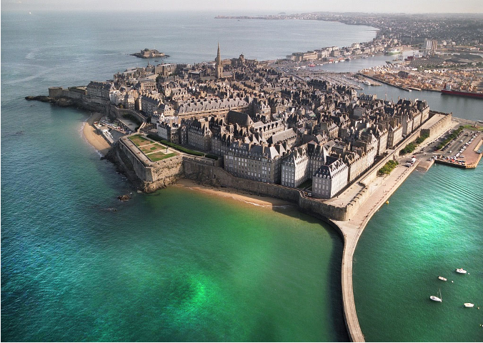
Photo report GSI’25 Geometric Science of Information
https://conference-gsi.org/

Slide 2
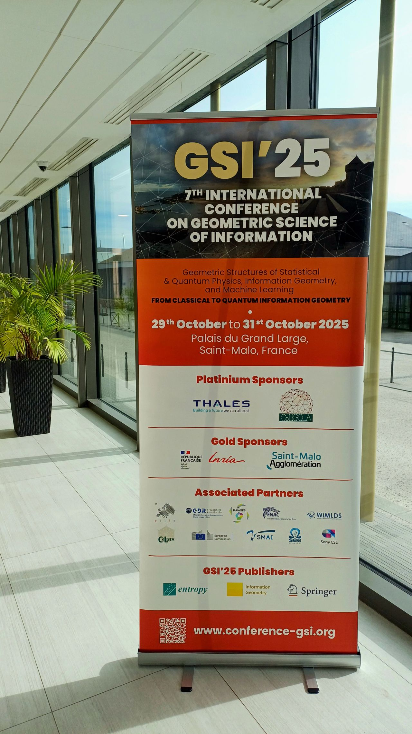
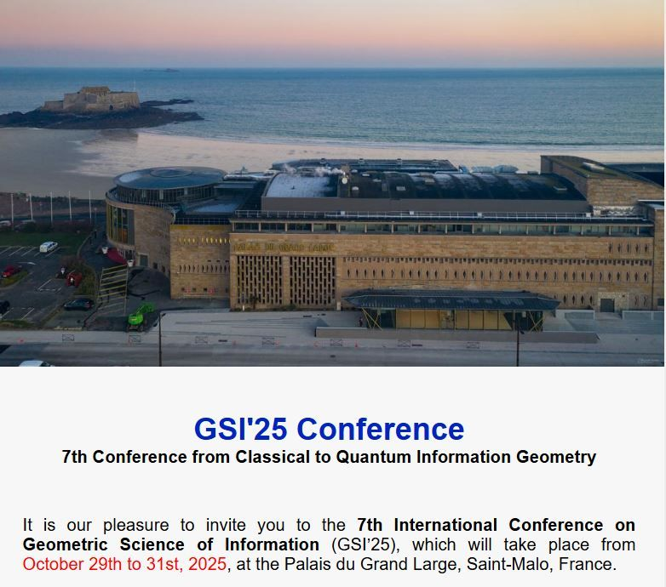

Slide 3
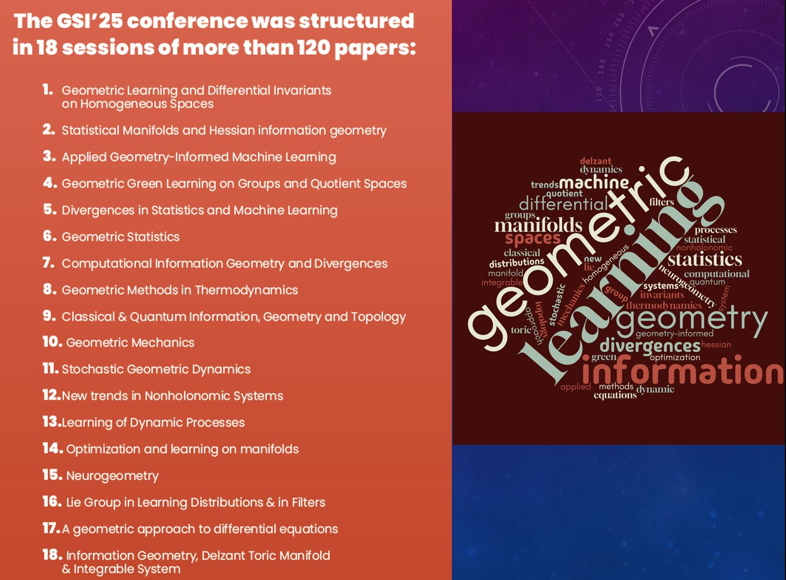

Slide 4
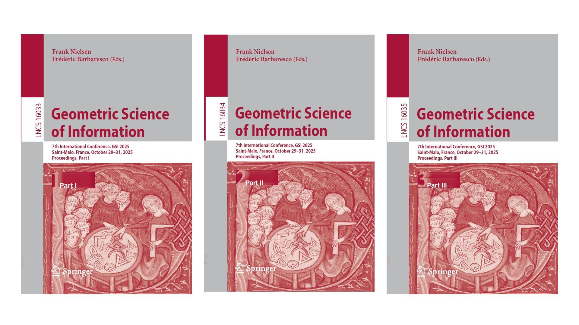
Proceedings
Springer Nature LNCS, links: vol 16033, vol 16034, vol 16035.

Slide 5
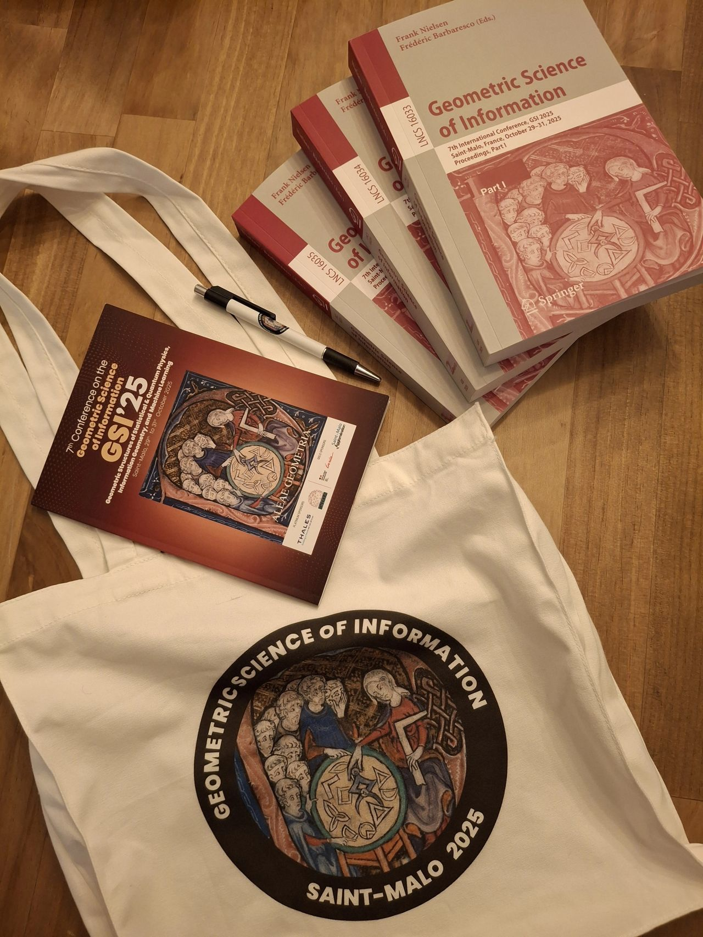


Slide 6
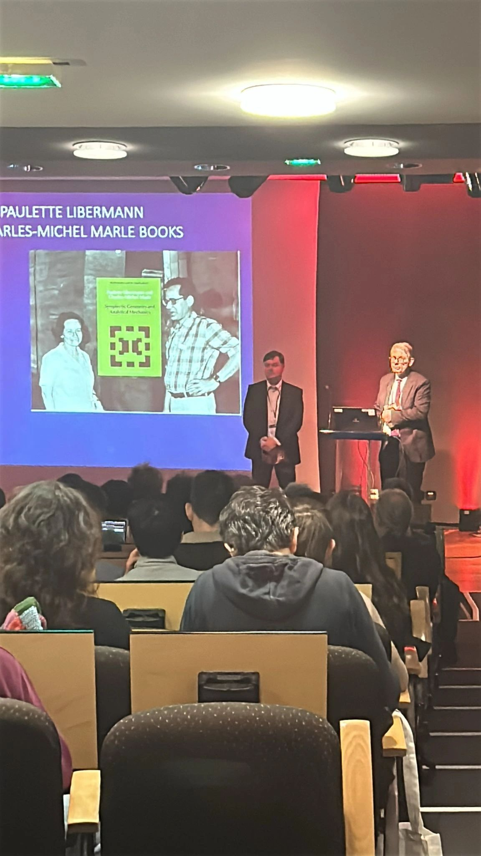
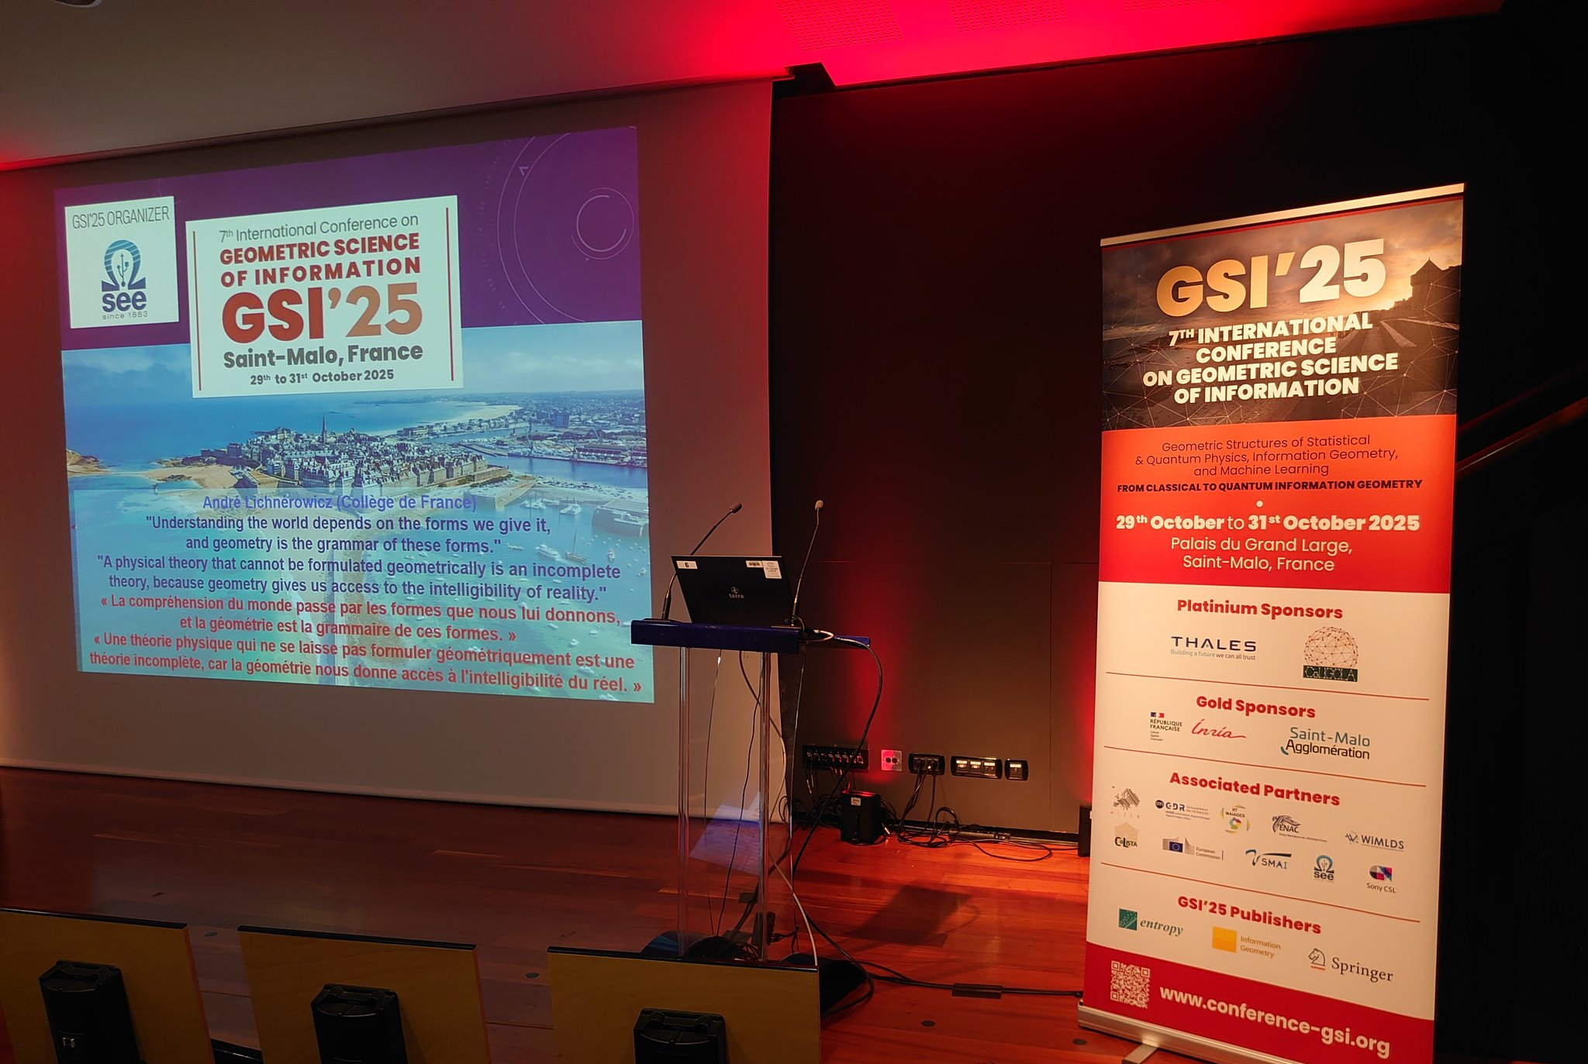
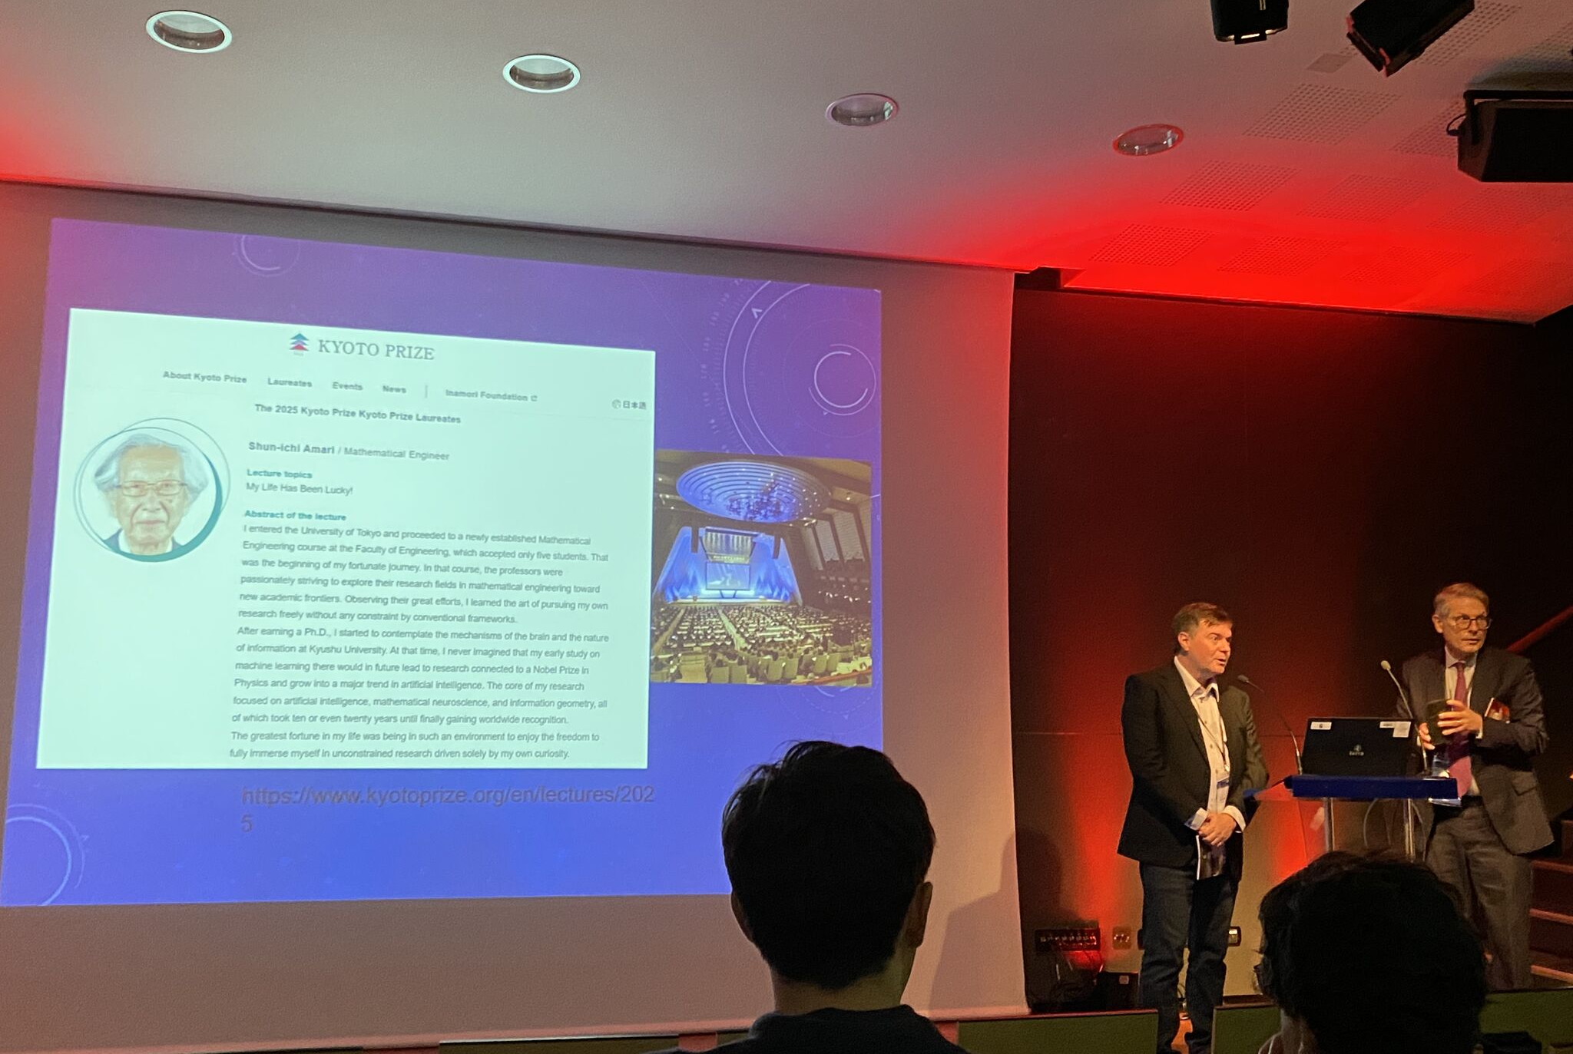
Opening session
Slides:
https://franknielsen.github.io/GSI/SEE-GSI'25-Opening.pdf

Slide 7
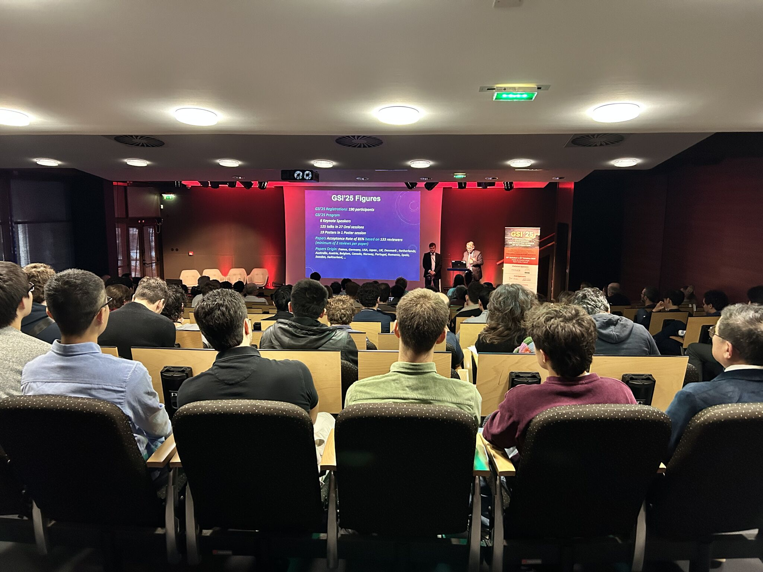

Slide 8
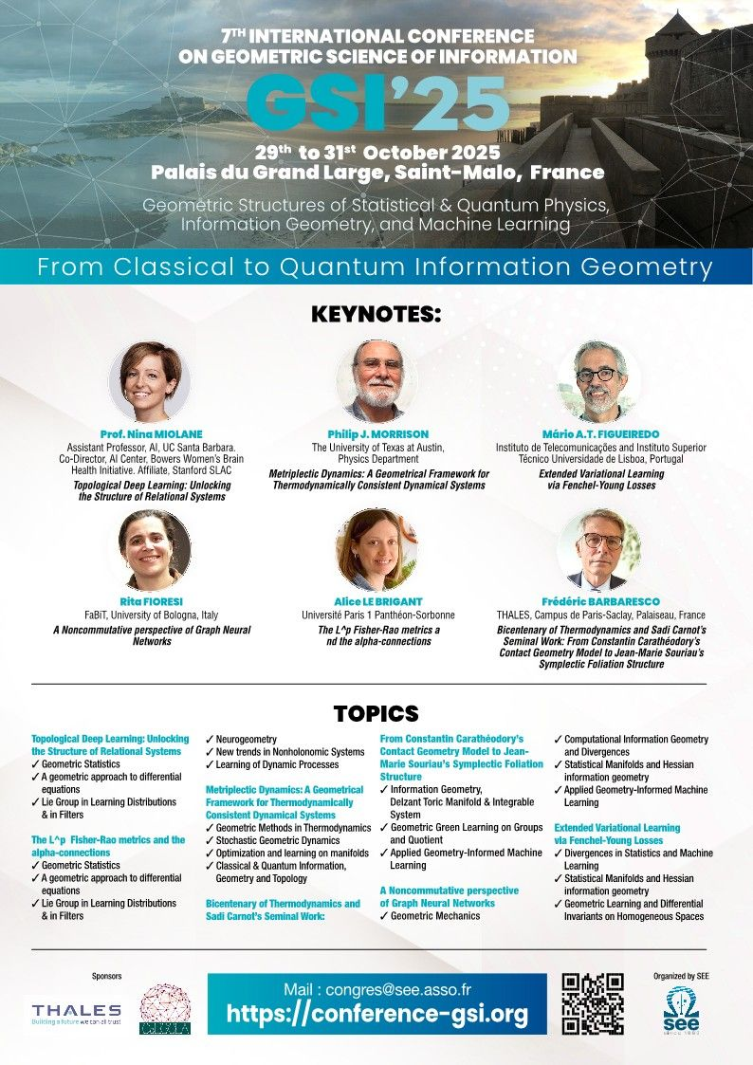

Slide 9
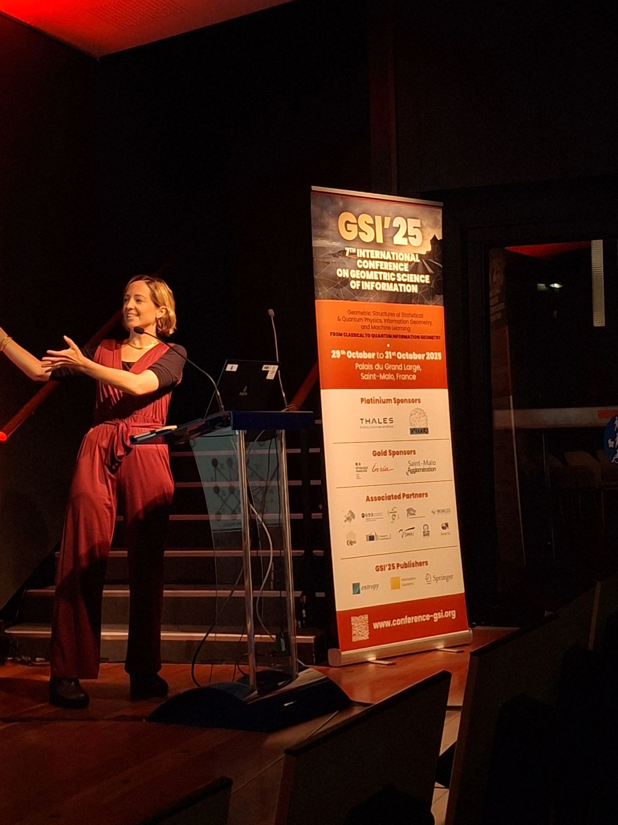
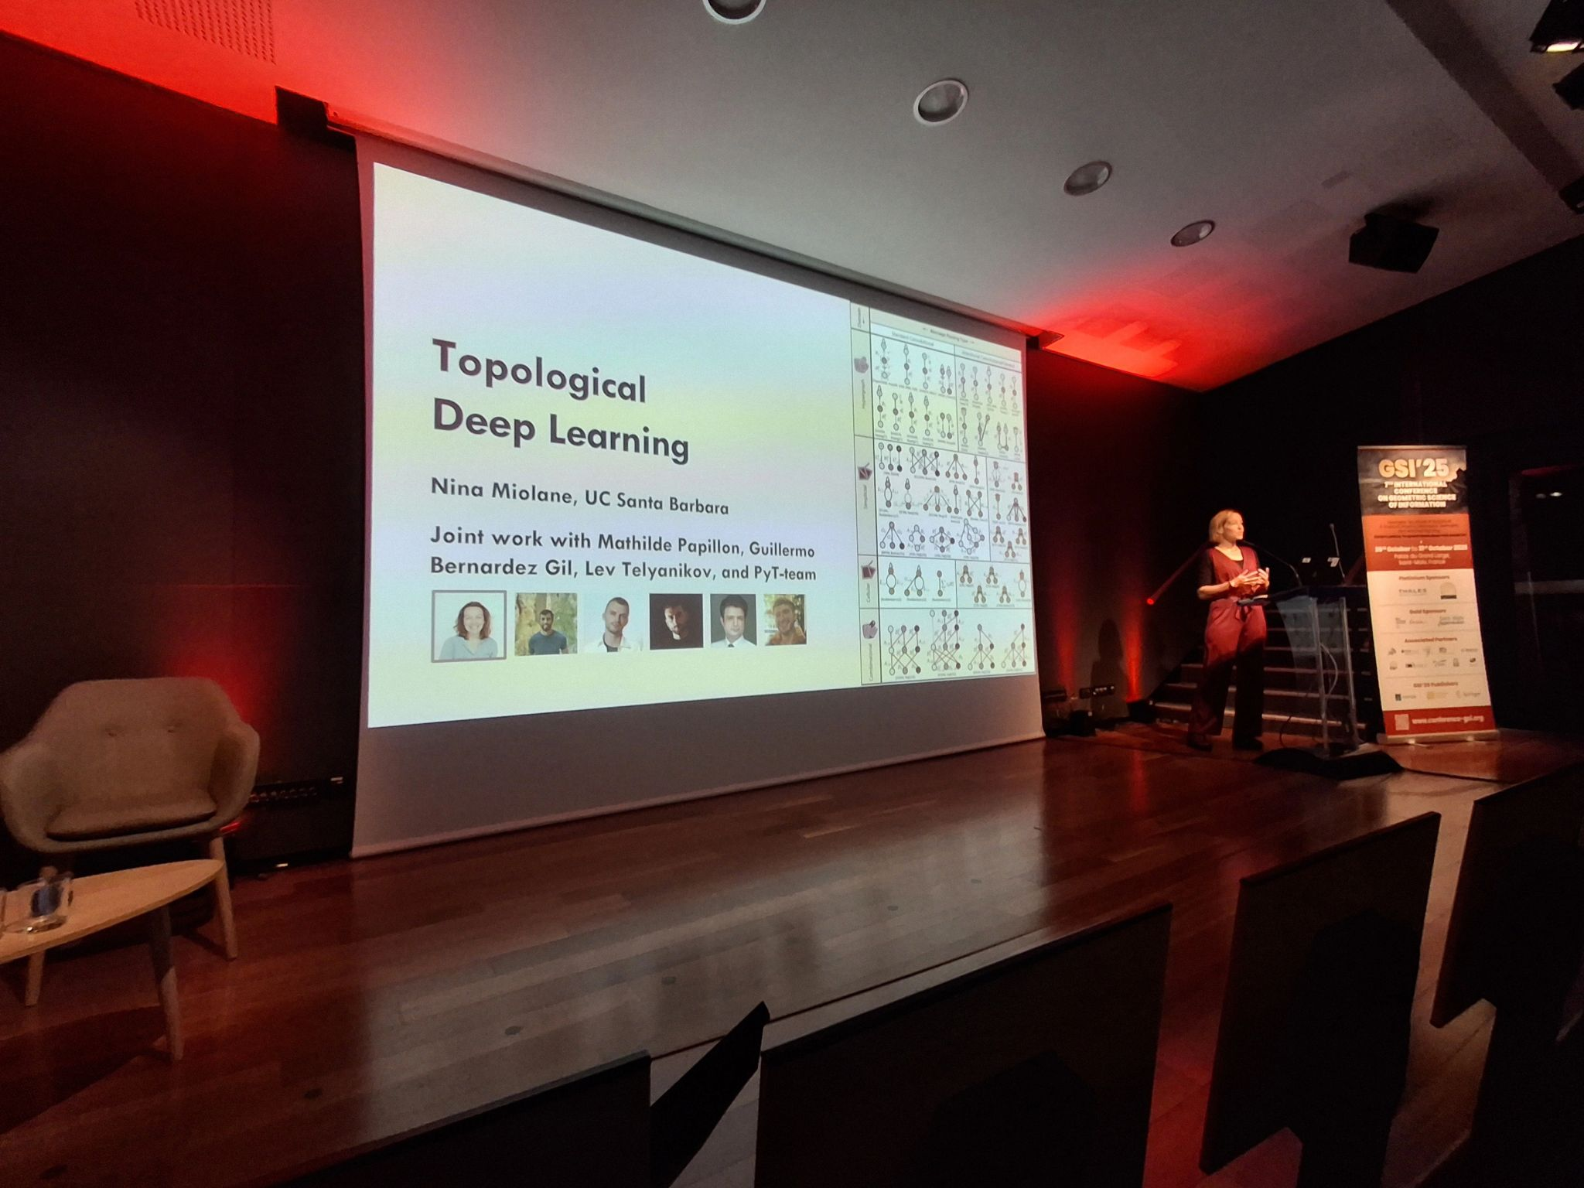

Slide 10
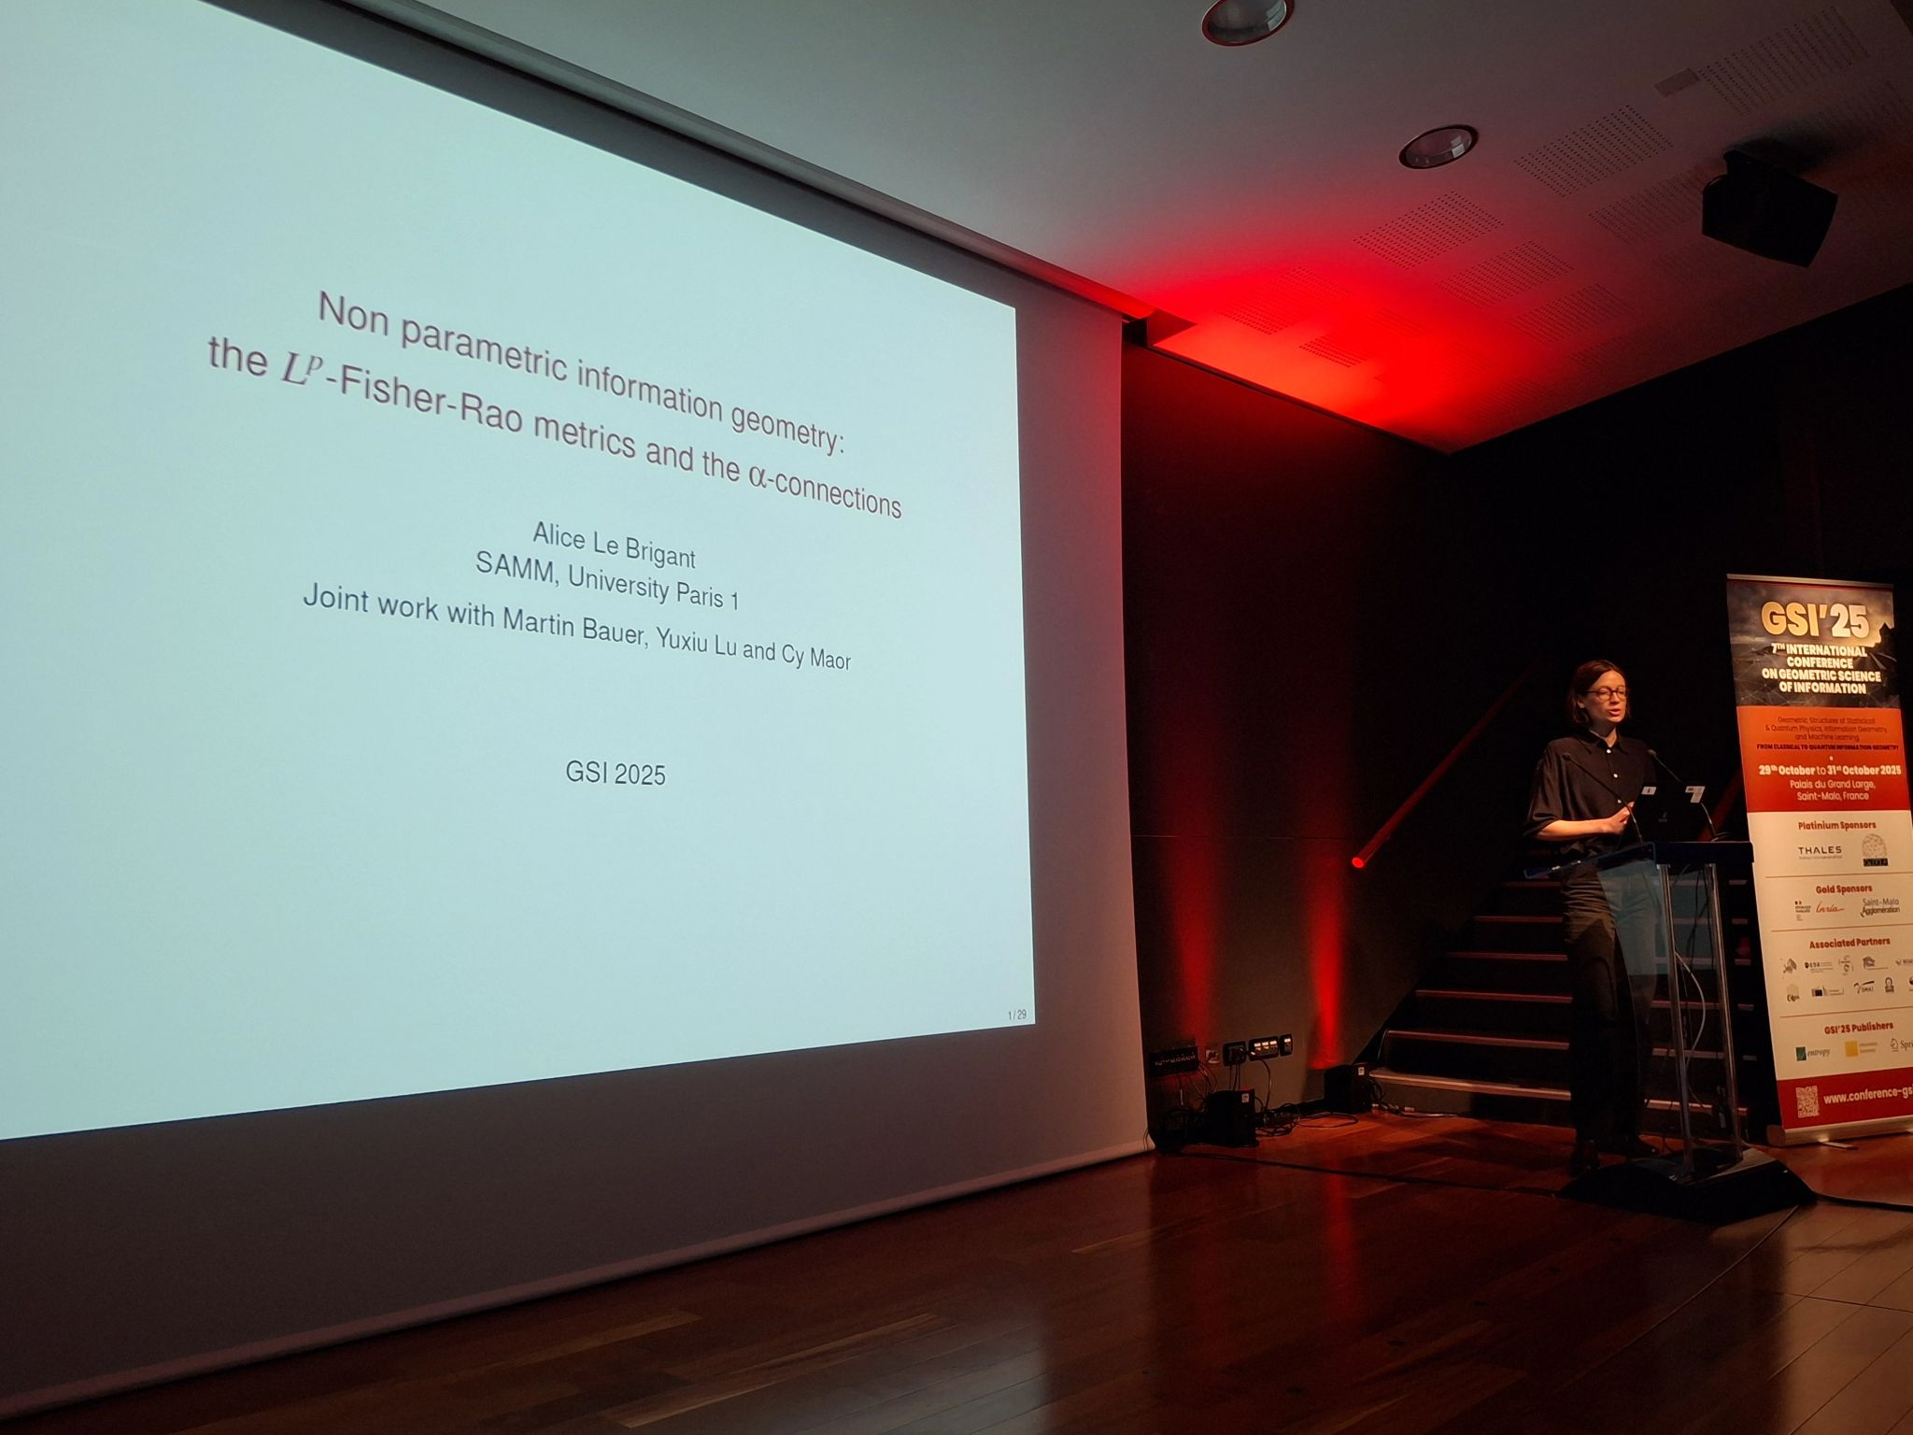
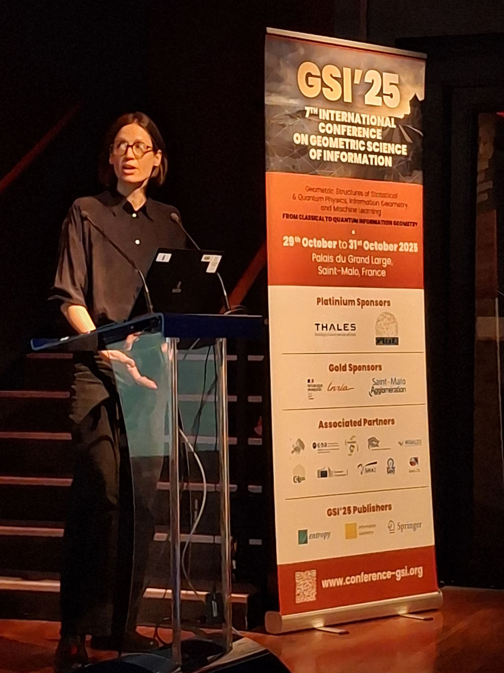

Slide 11
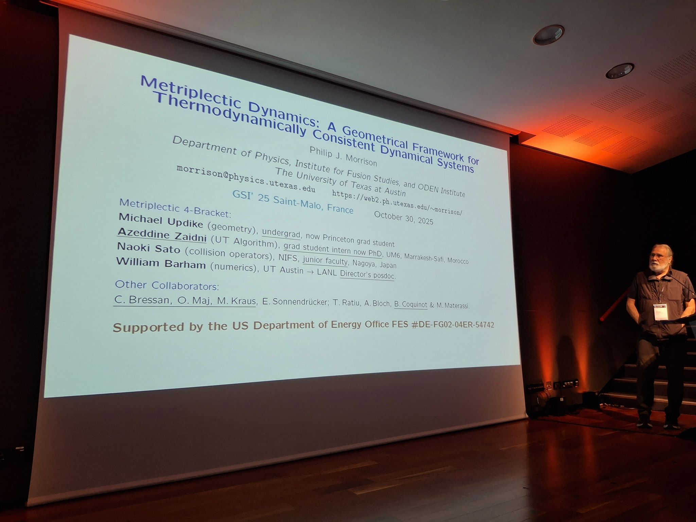
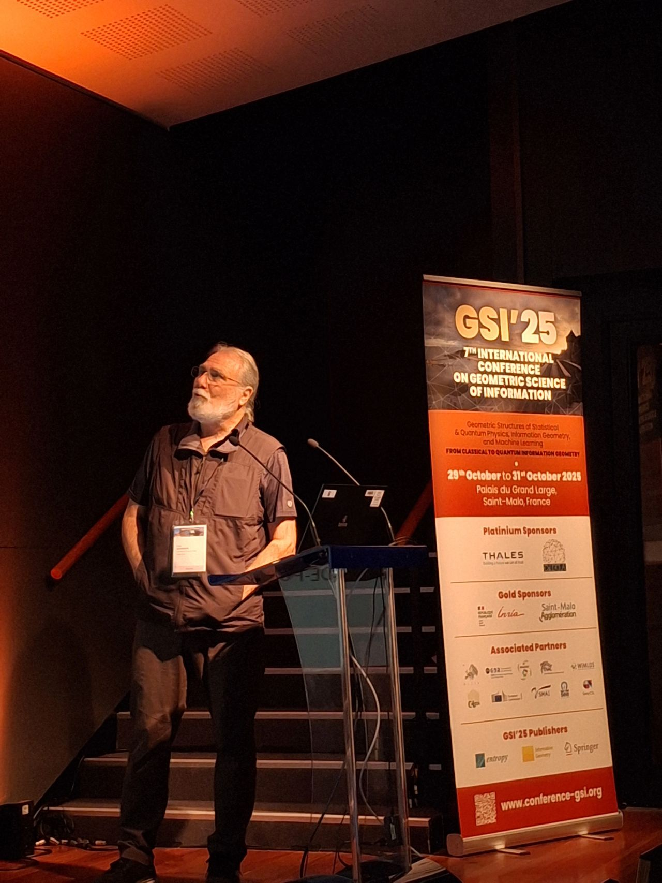

Slide 12
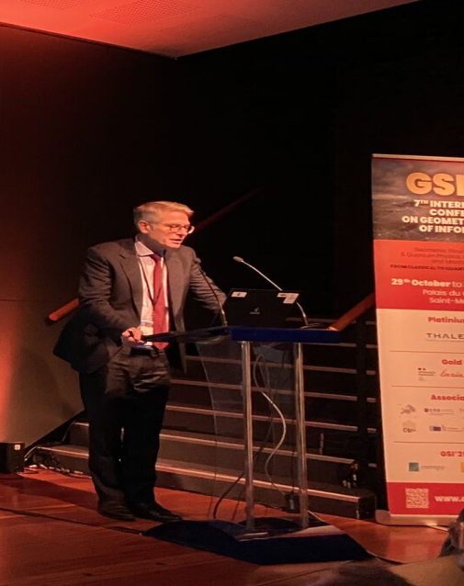
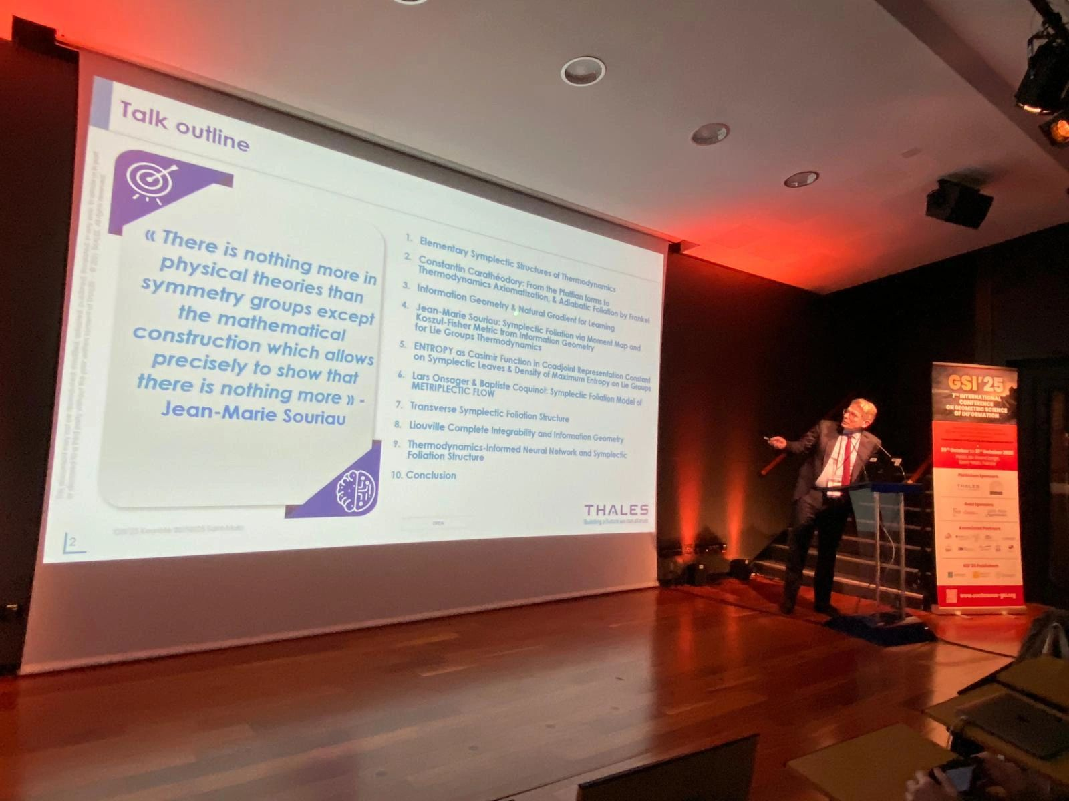

Slide 13
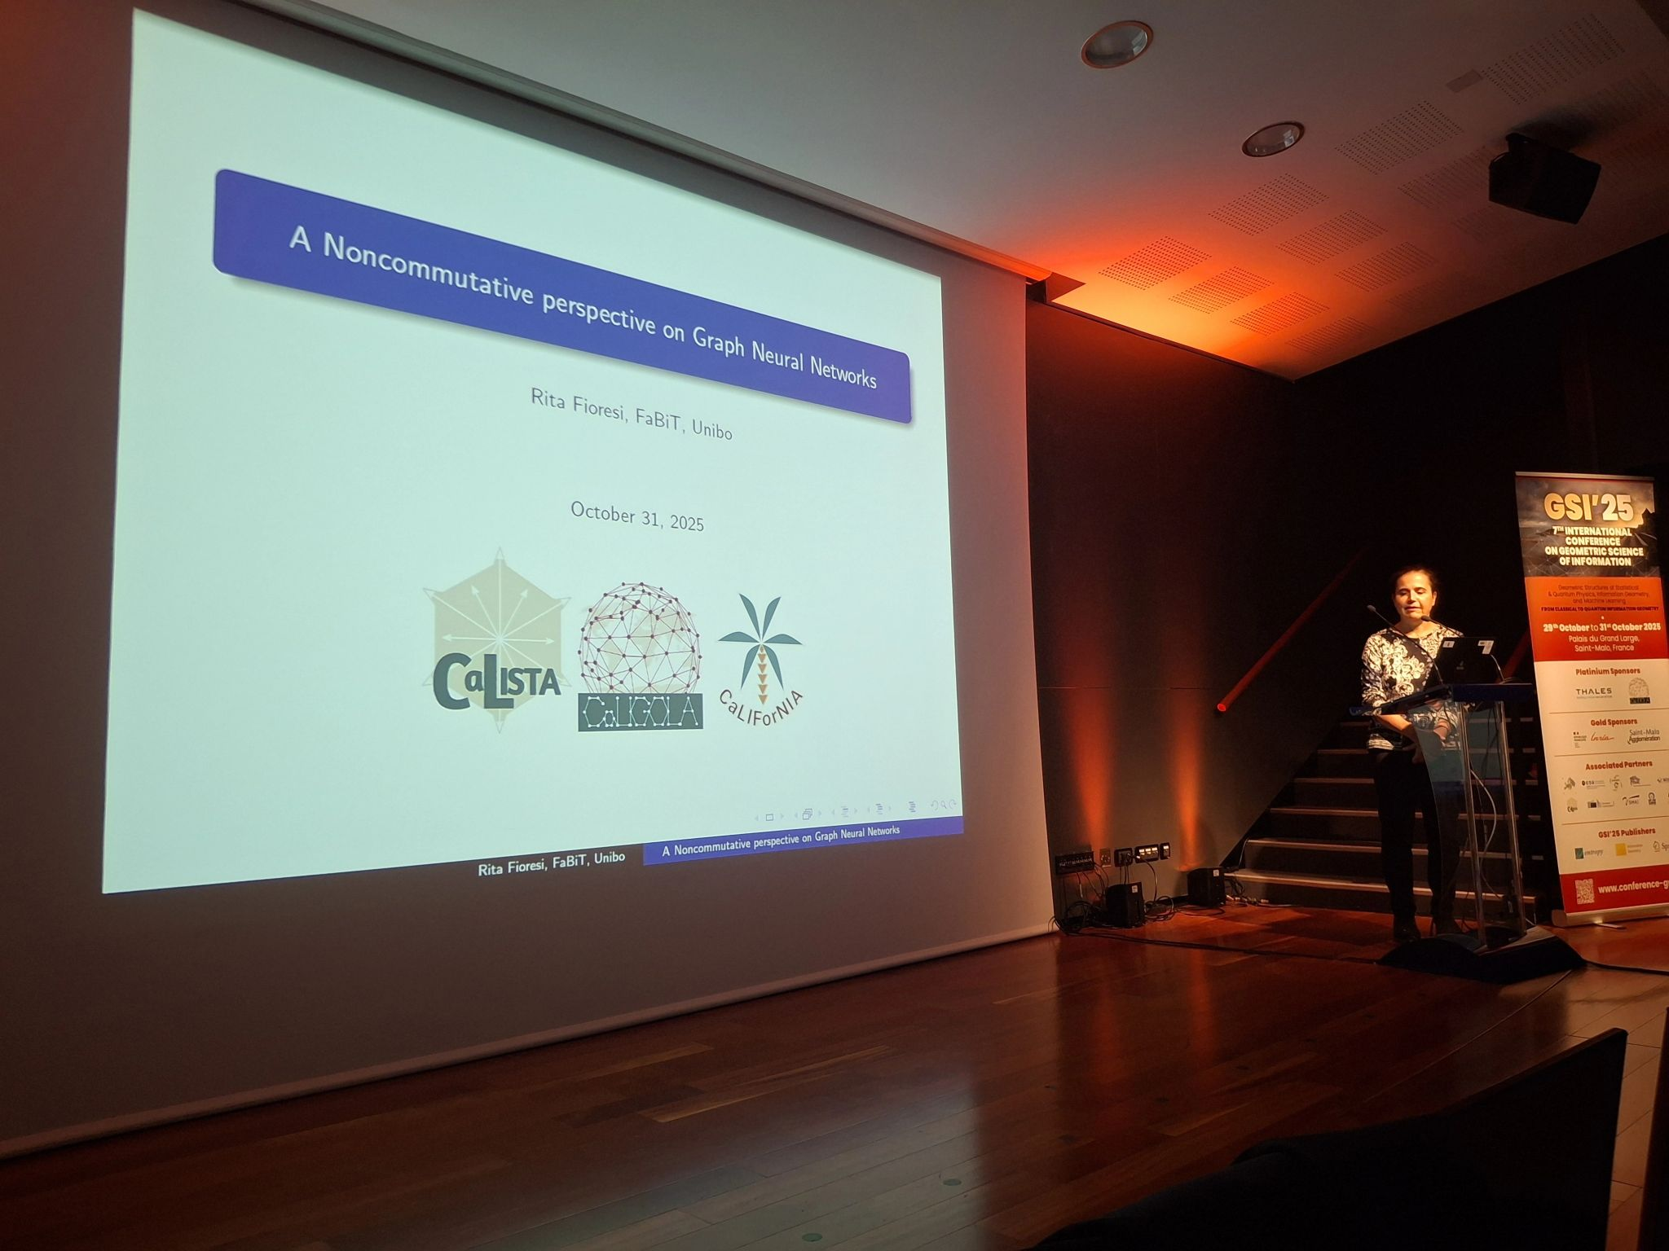
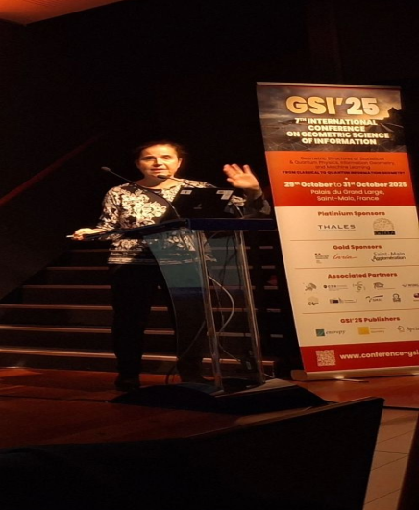

Slide 14
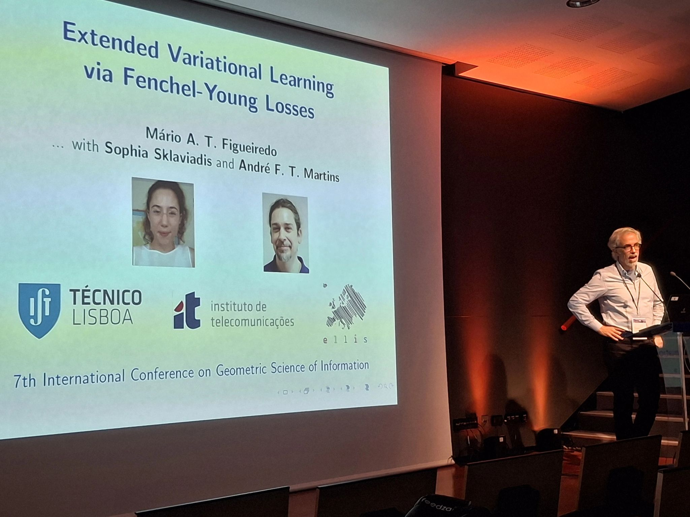
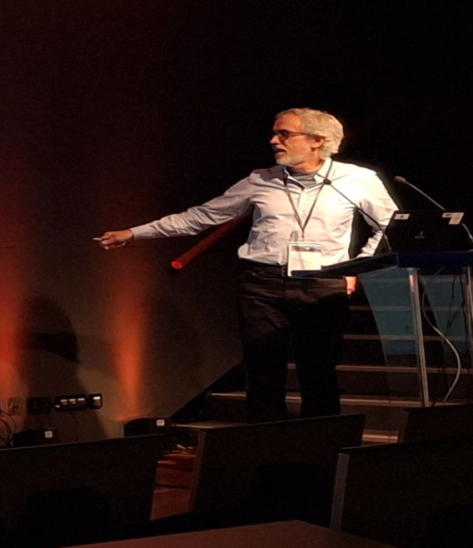

Slide 15
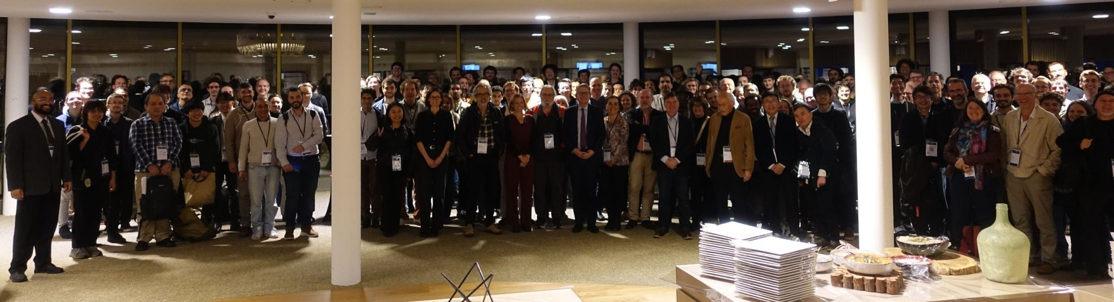
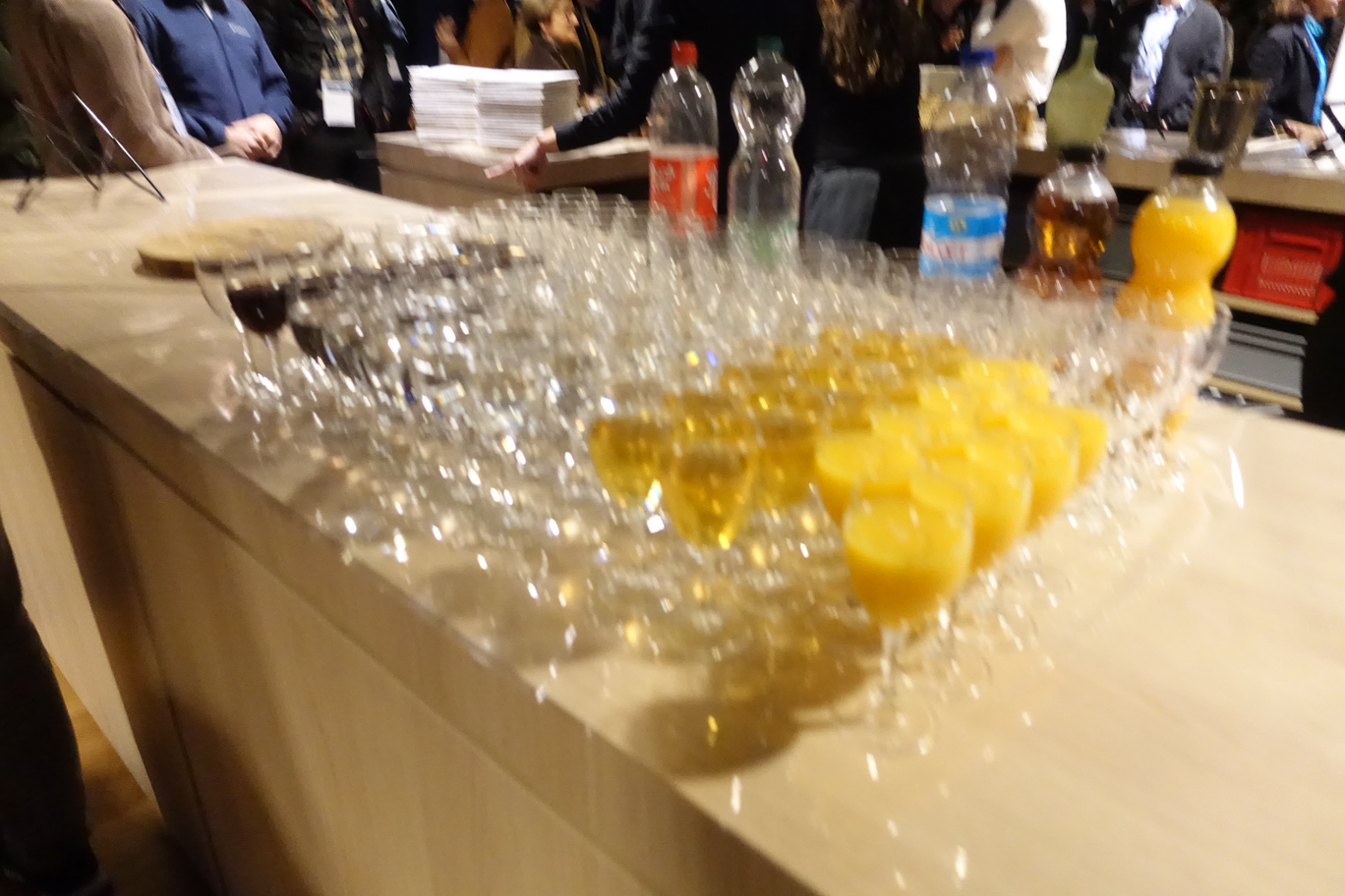
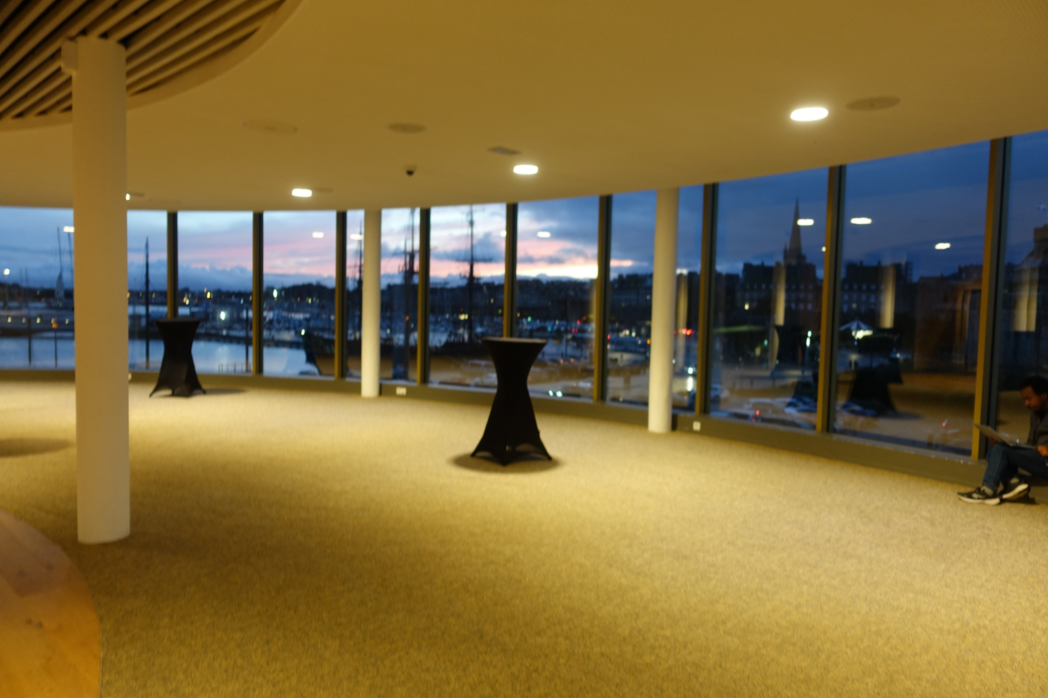
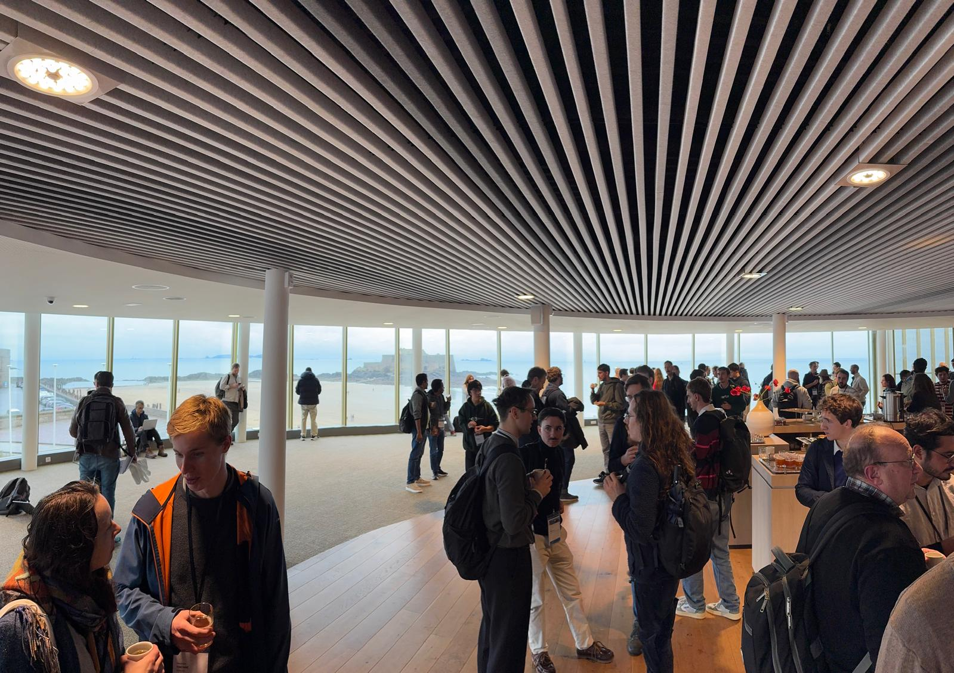
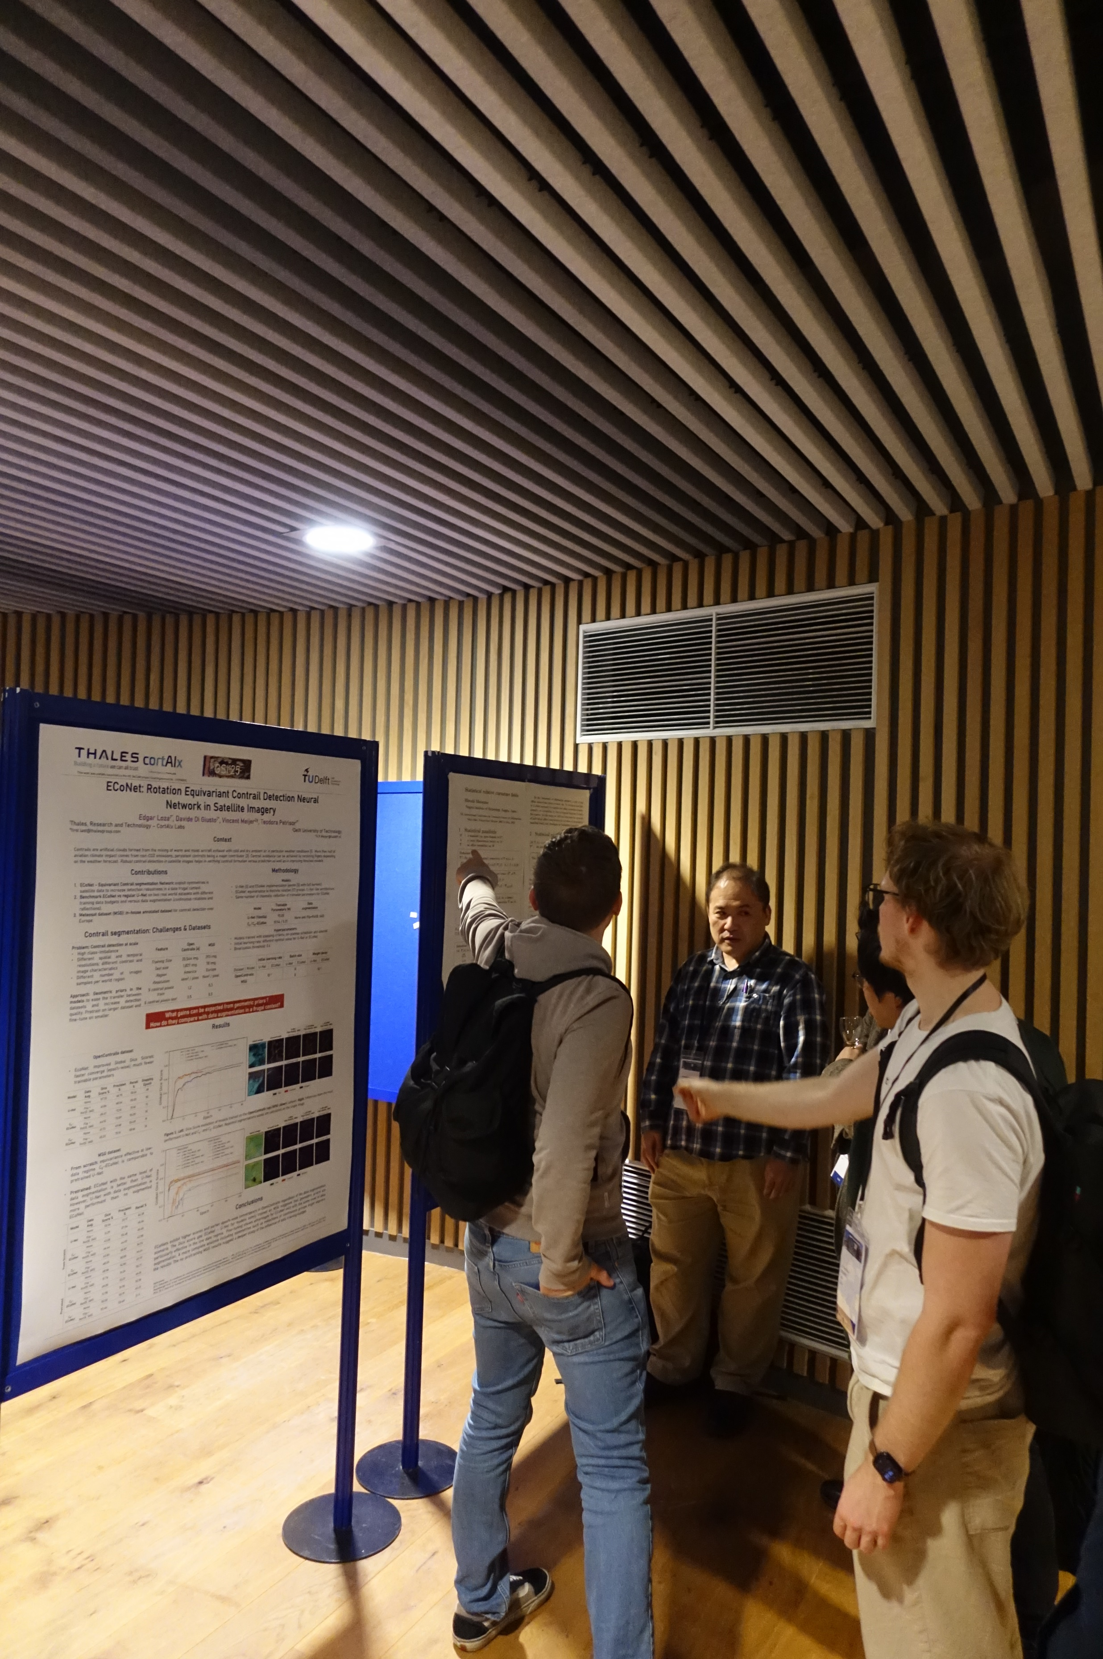
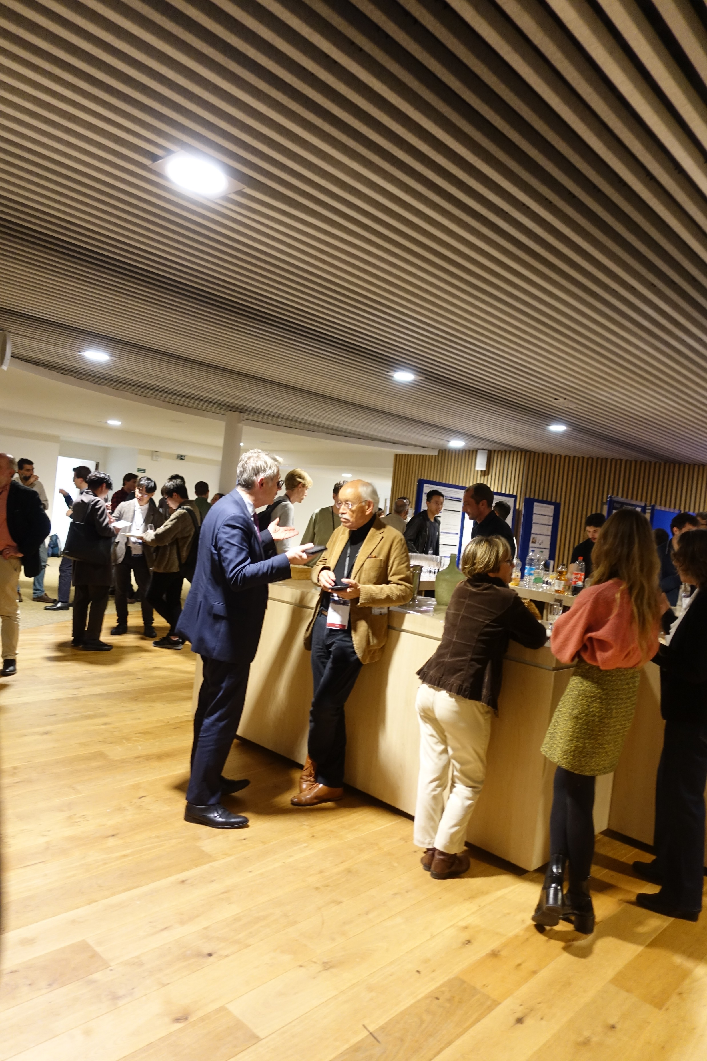
Cocktail reception in la Rotonde Surcouf

Slide 16
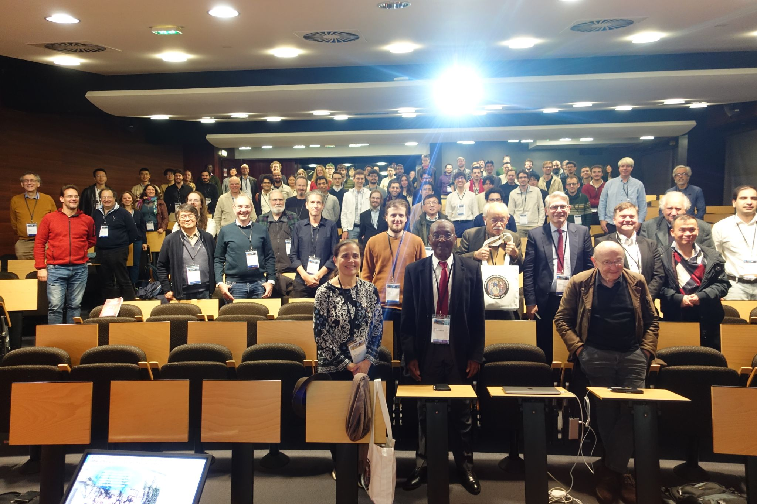
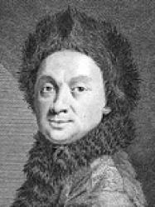
Group photo in Maupertuis Auditorium

Slide 17
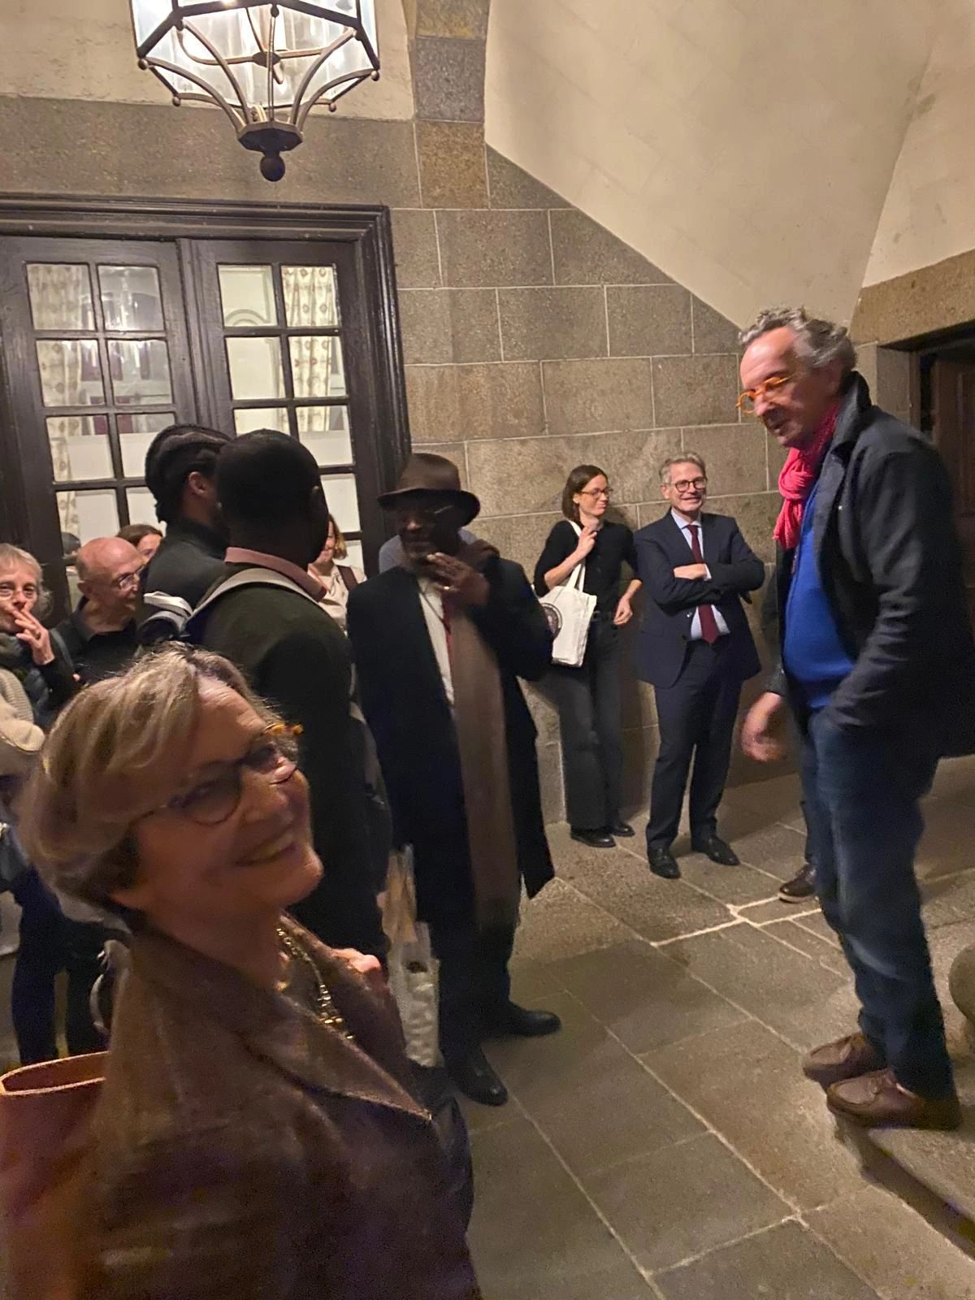
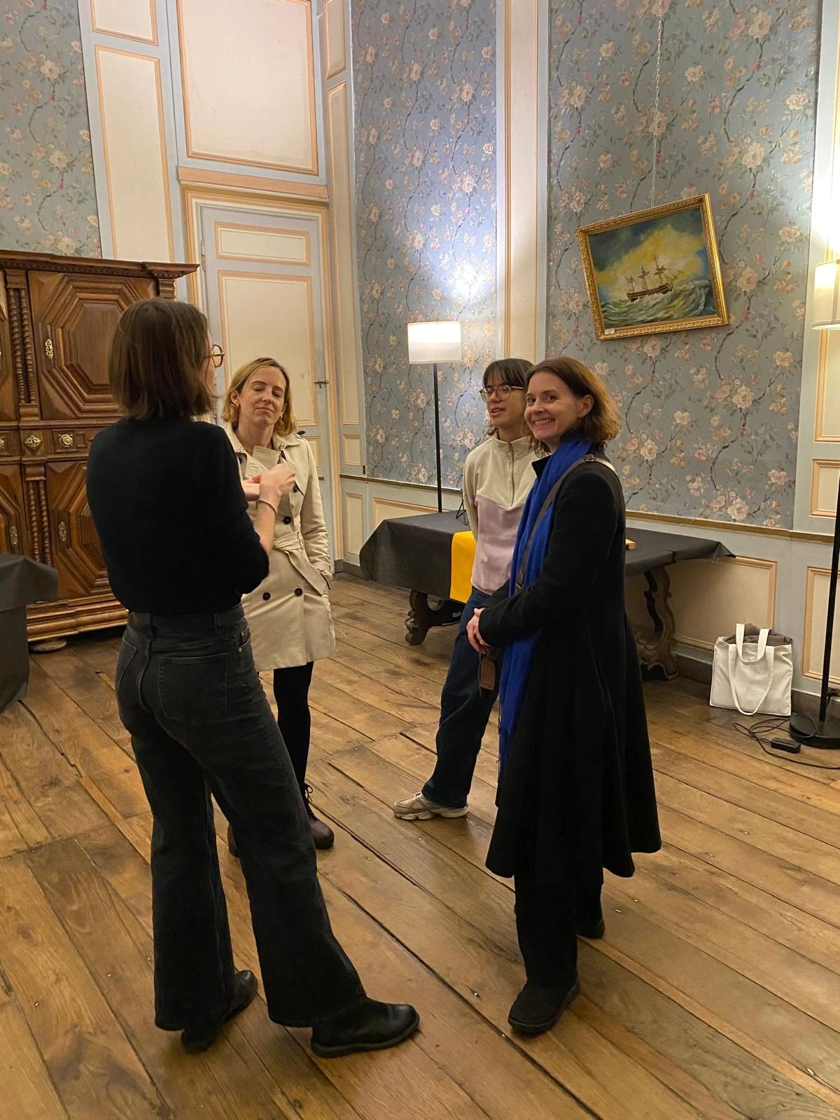
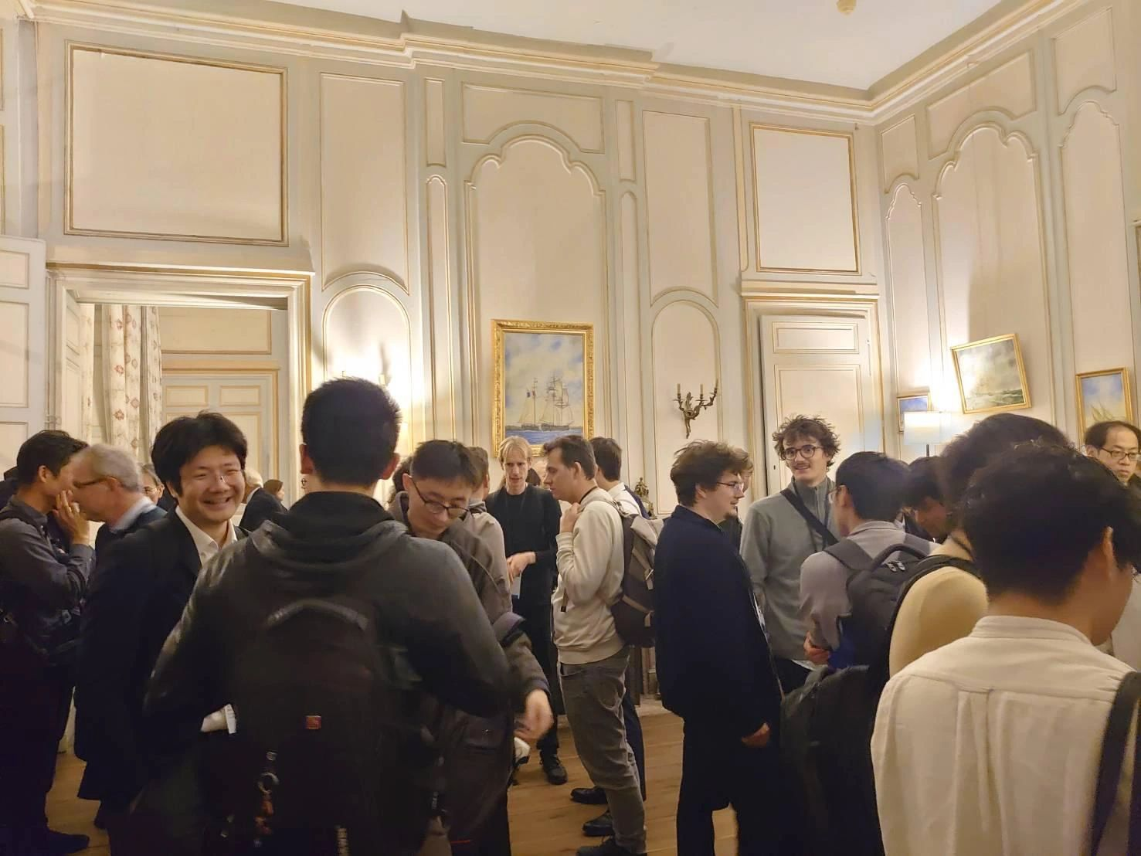
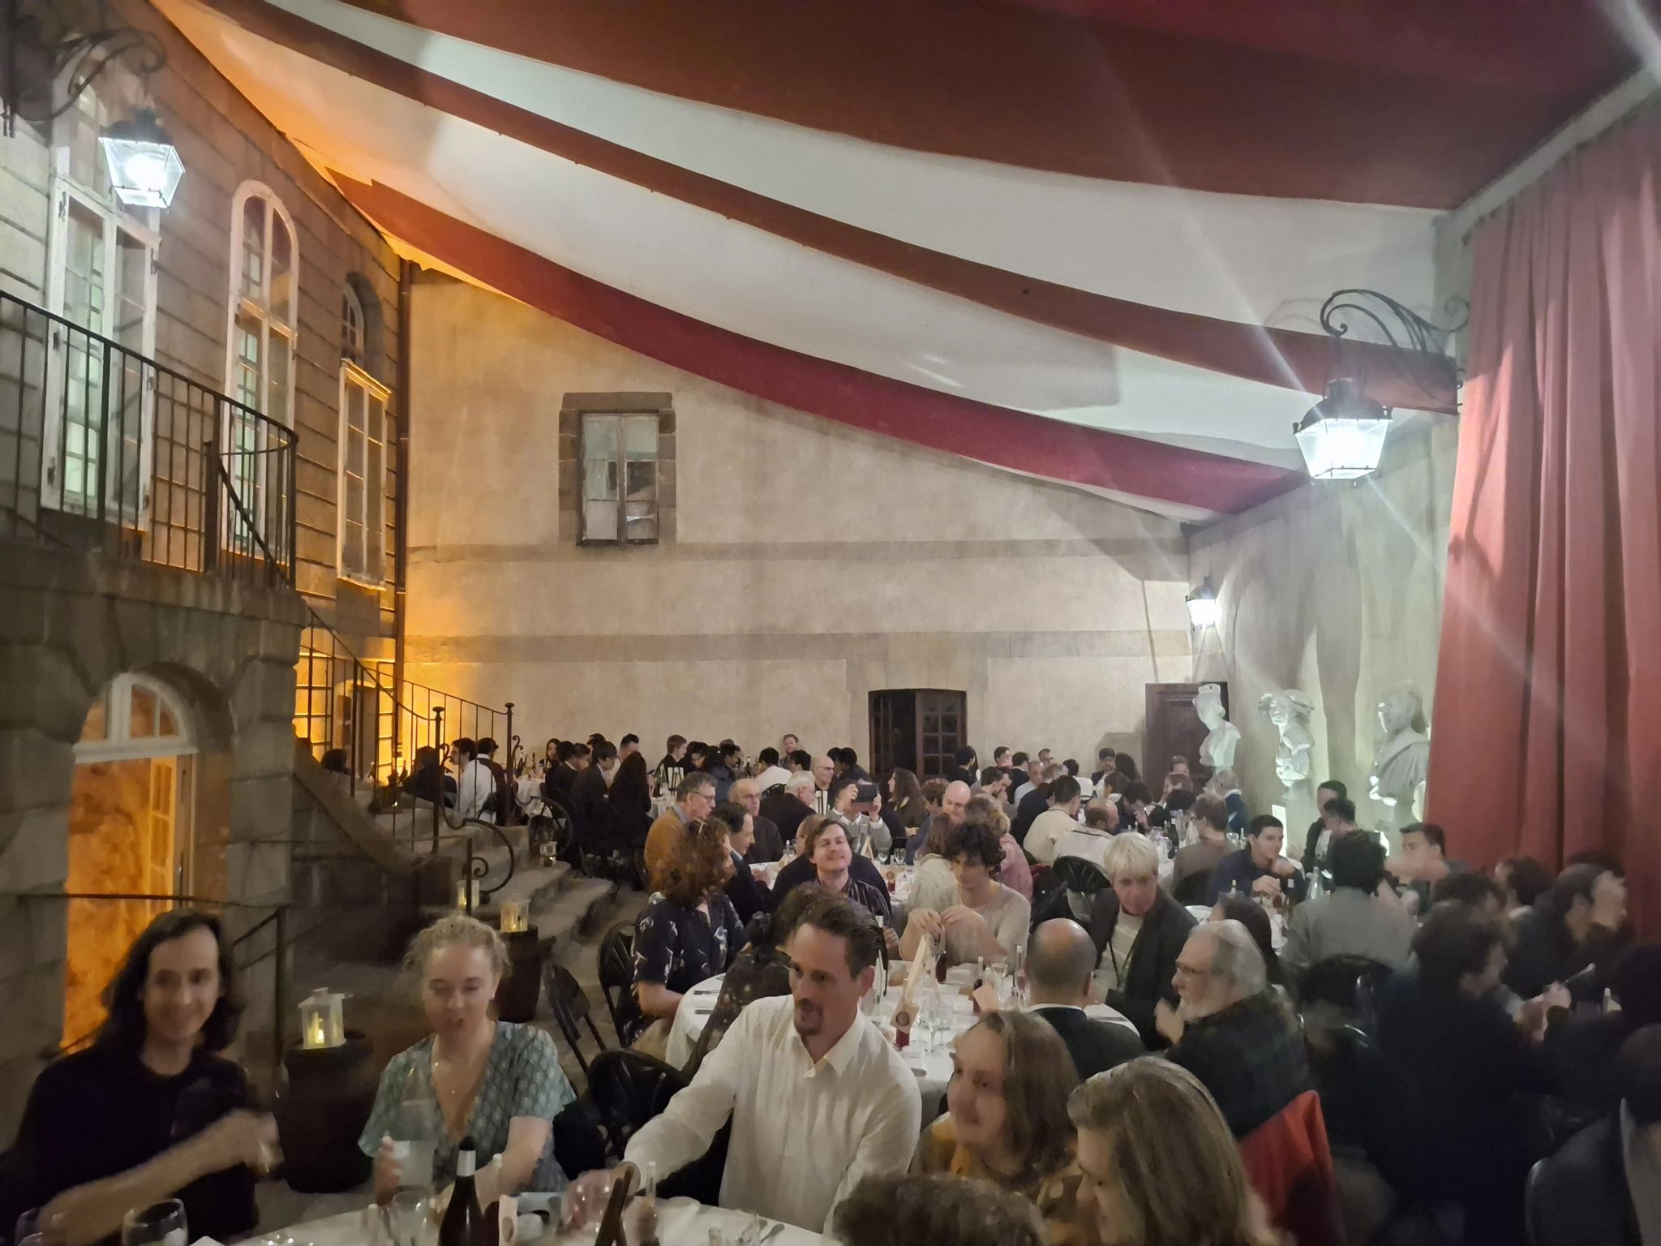
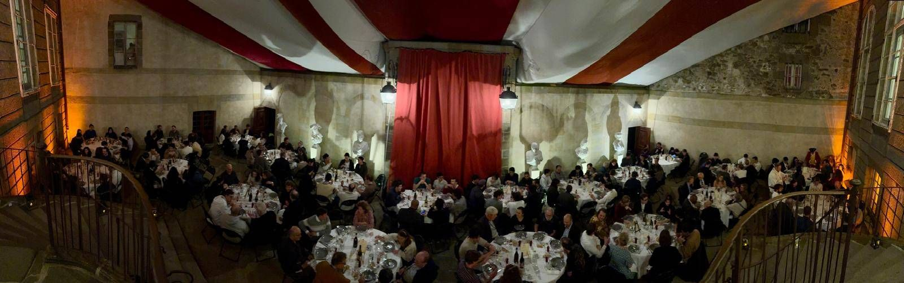
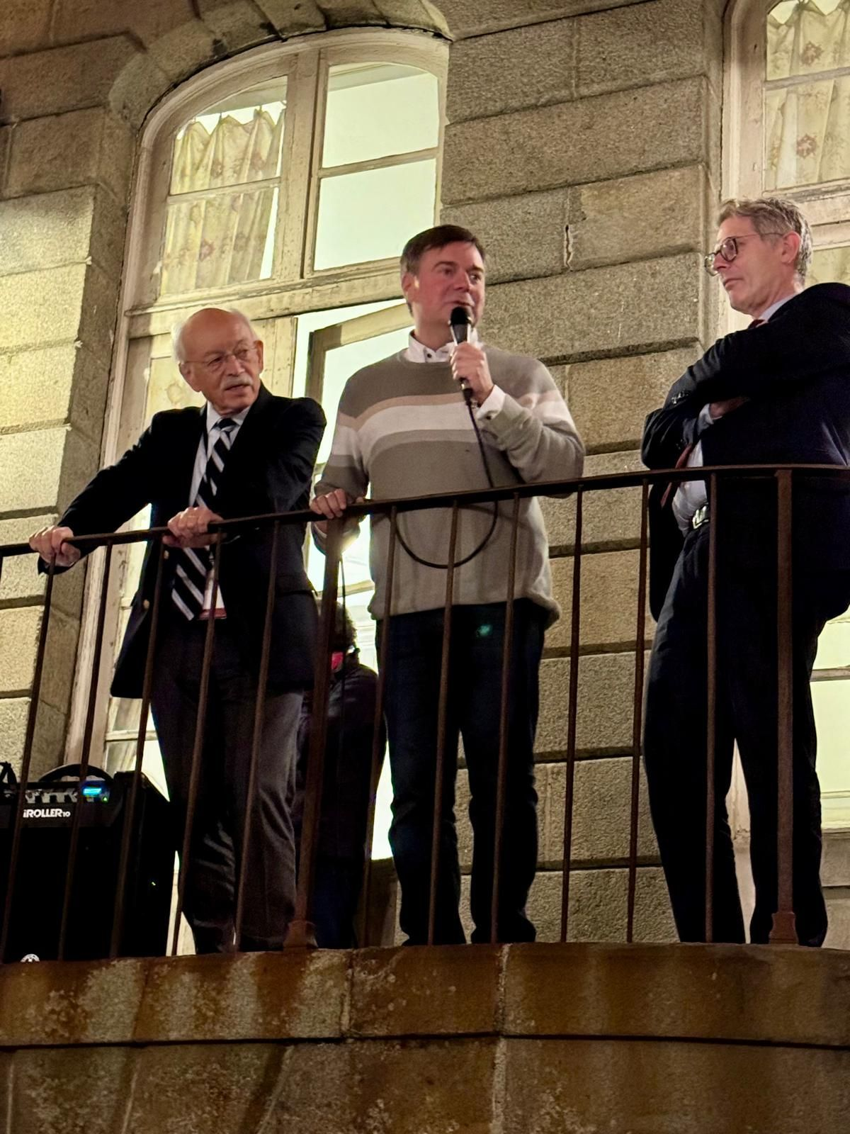
Demeure du Corsaire, Hôtel Magon, Saint-Malo

Slide 18
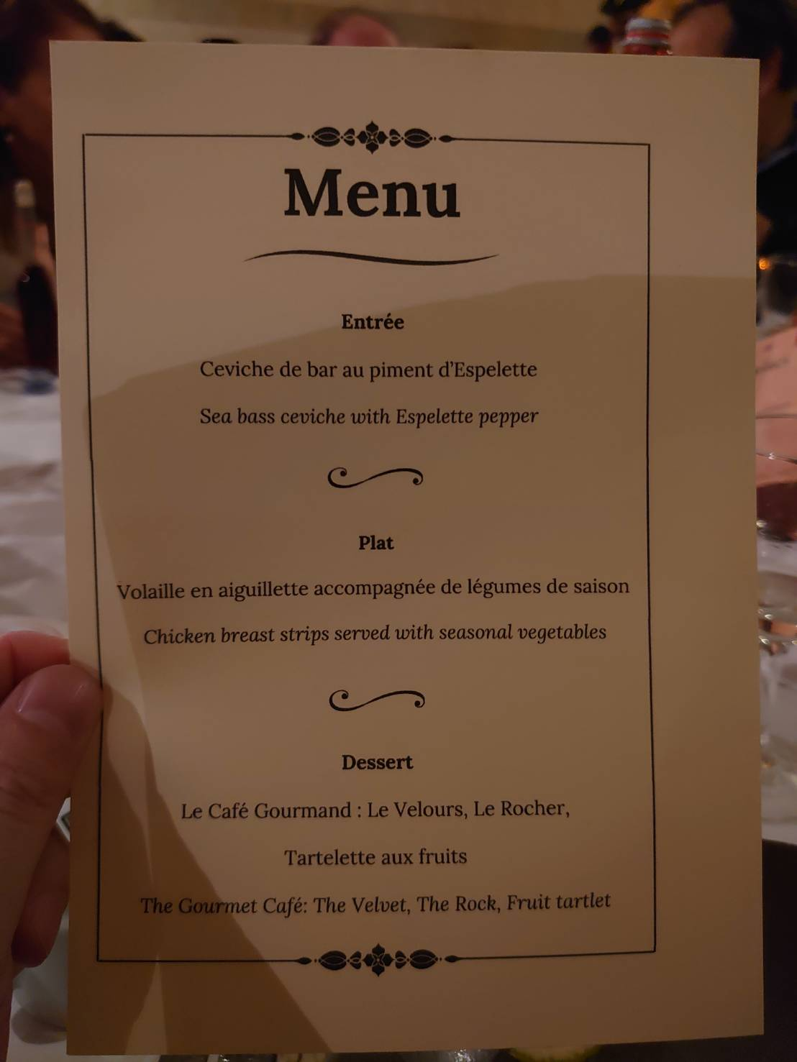
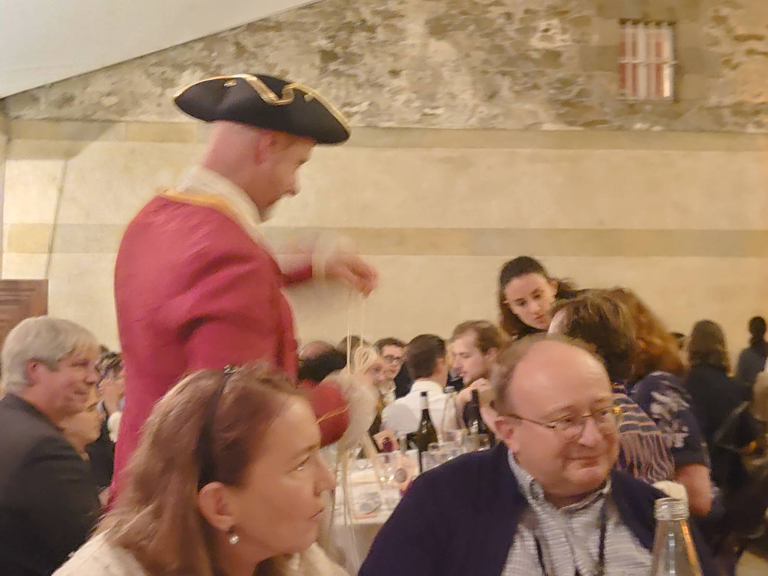
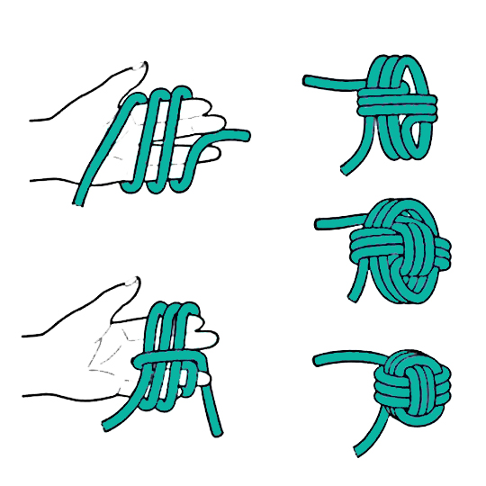
Marine knot
Noeud marin: pomme de touline
(etymology: from English towline)

Slide 19
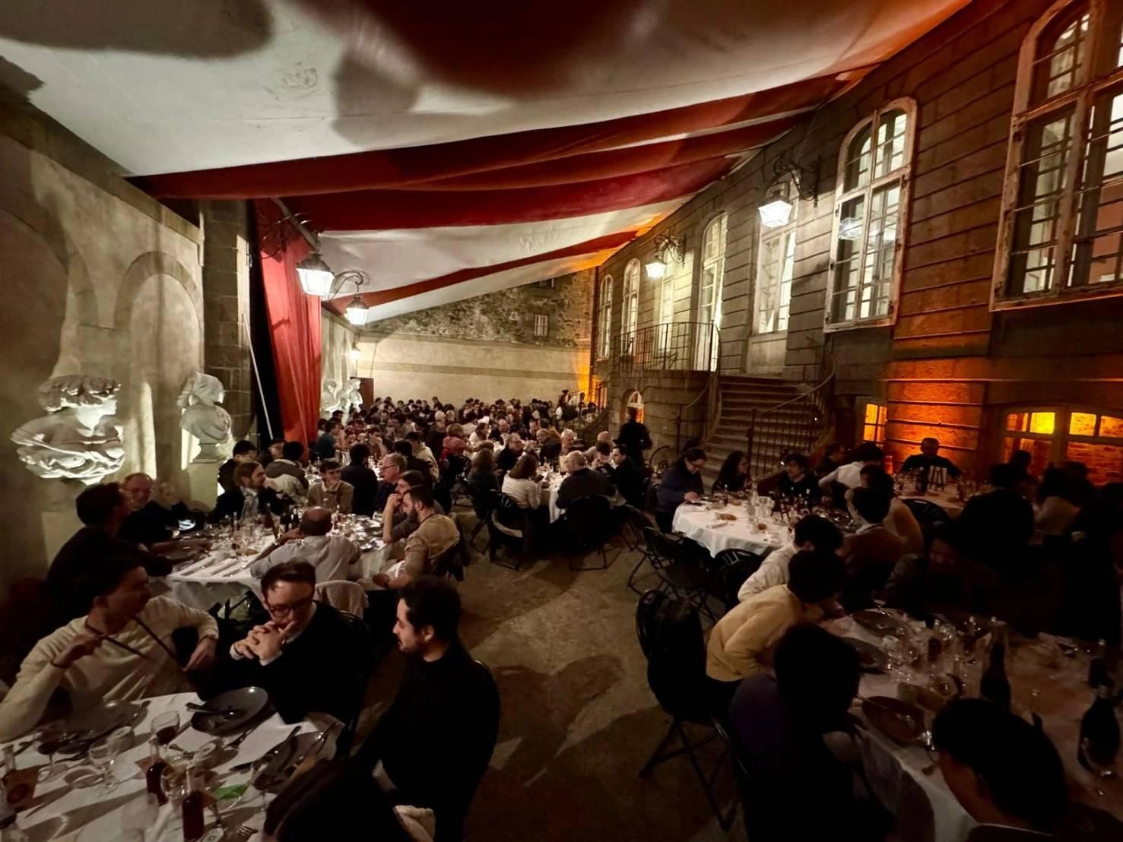
Gala dinner

Slide 20
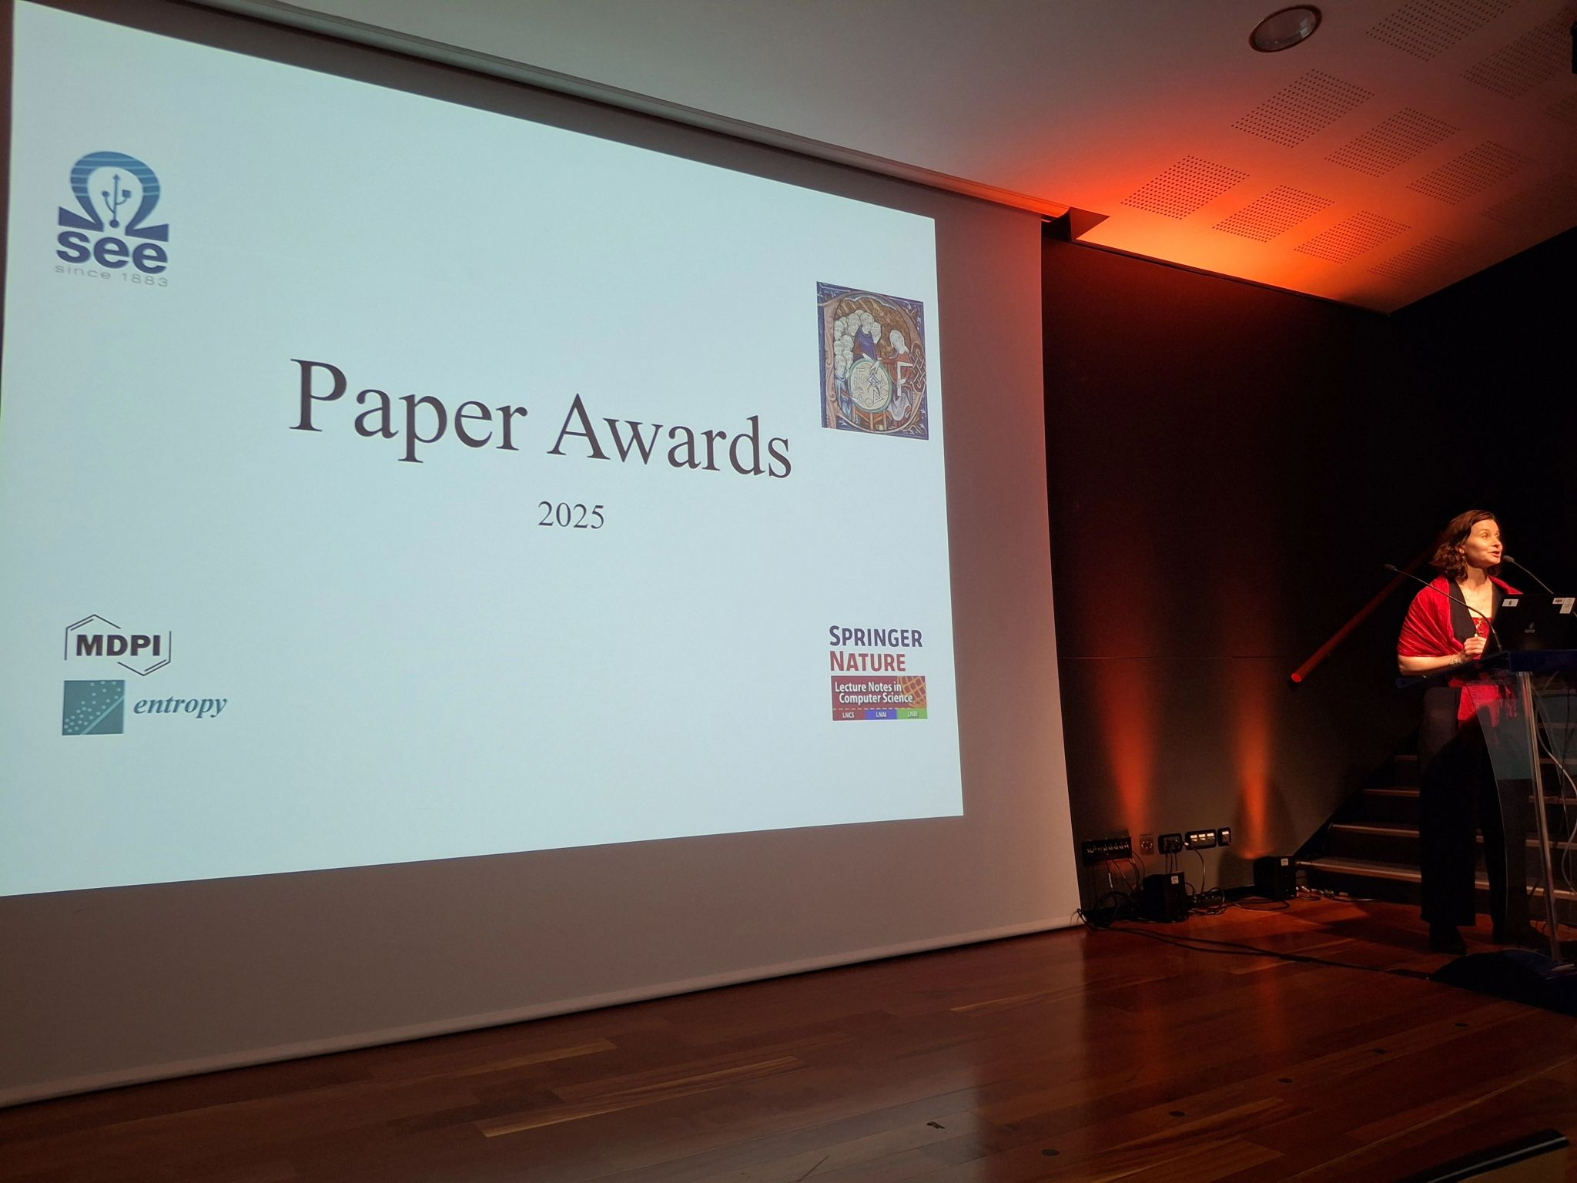
Jury, president: Alice Barbara Tumpach

Slide 21
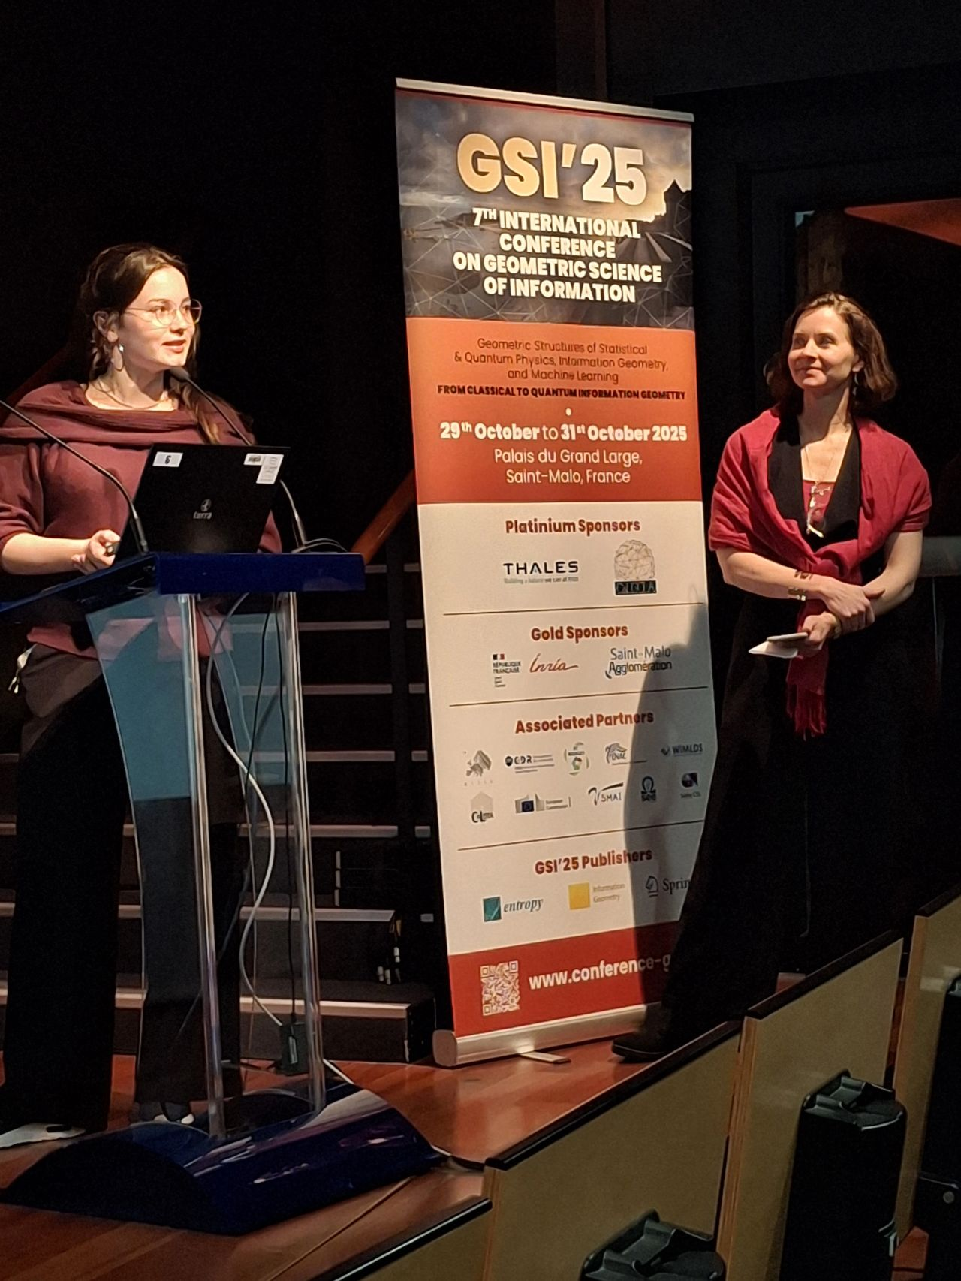
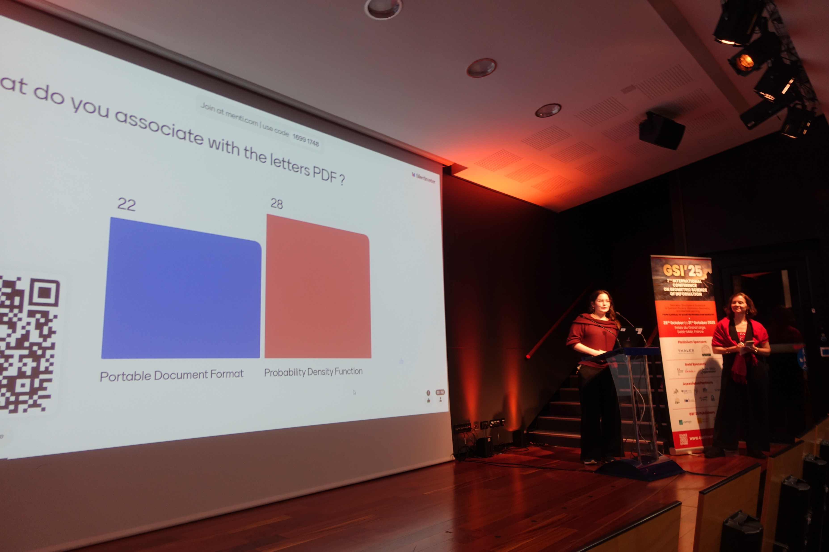

Slide 22
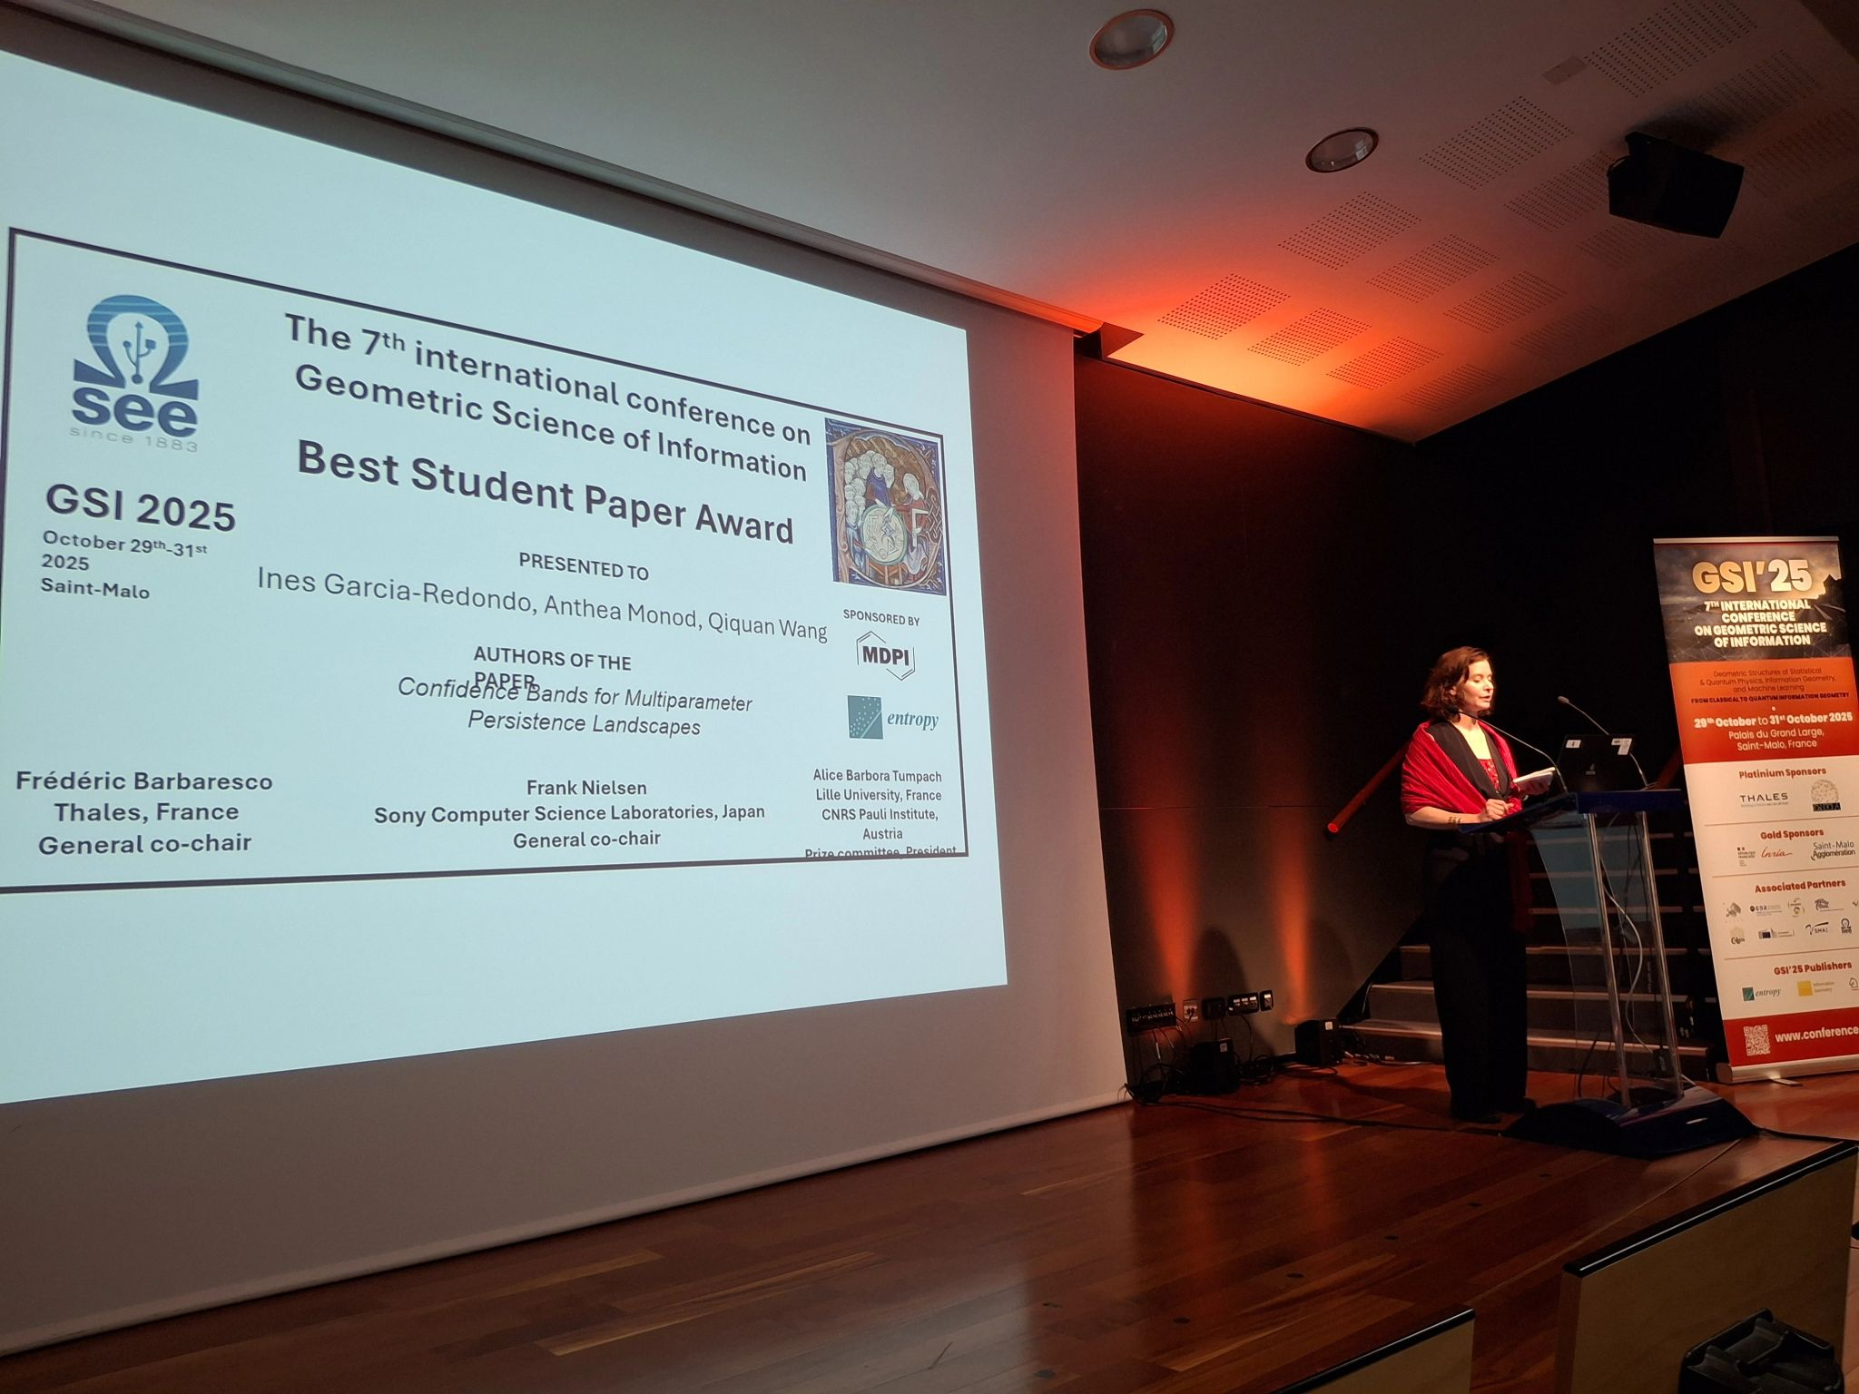

Slide 23
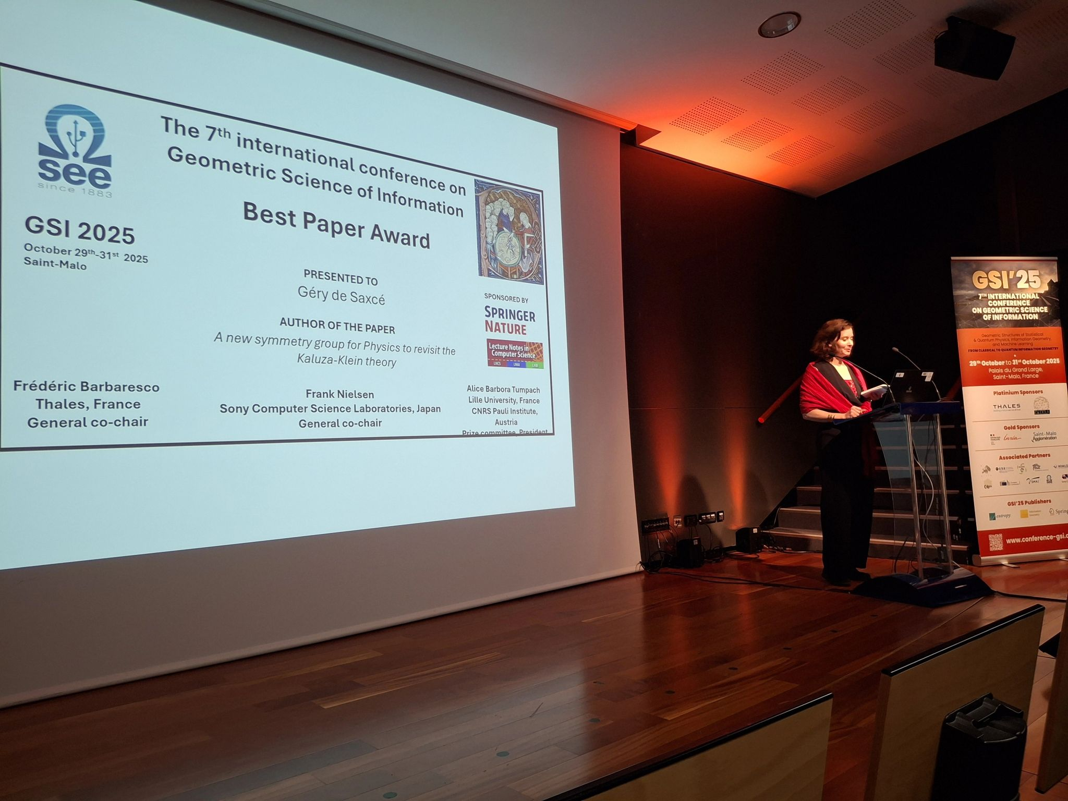

Slide 24
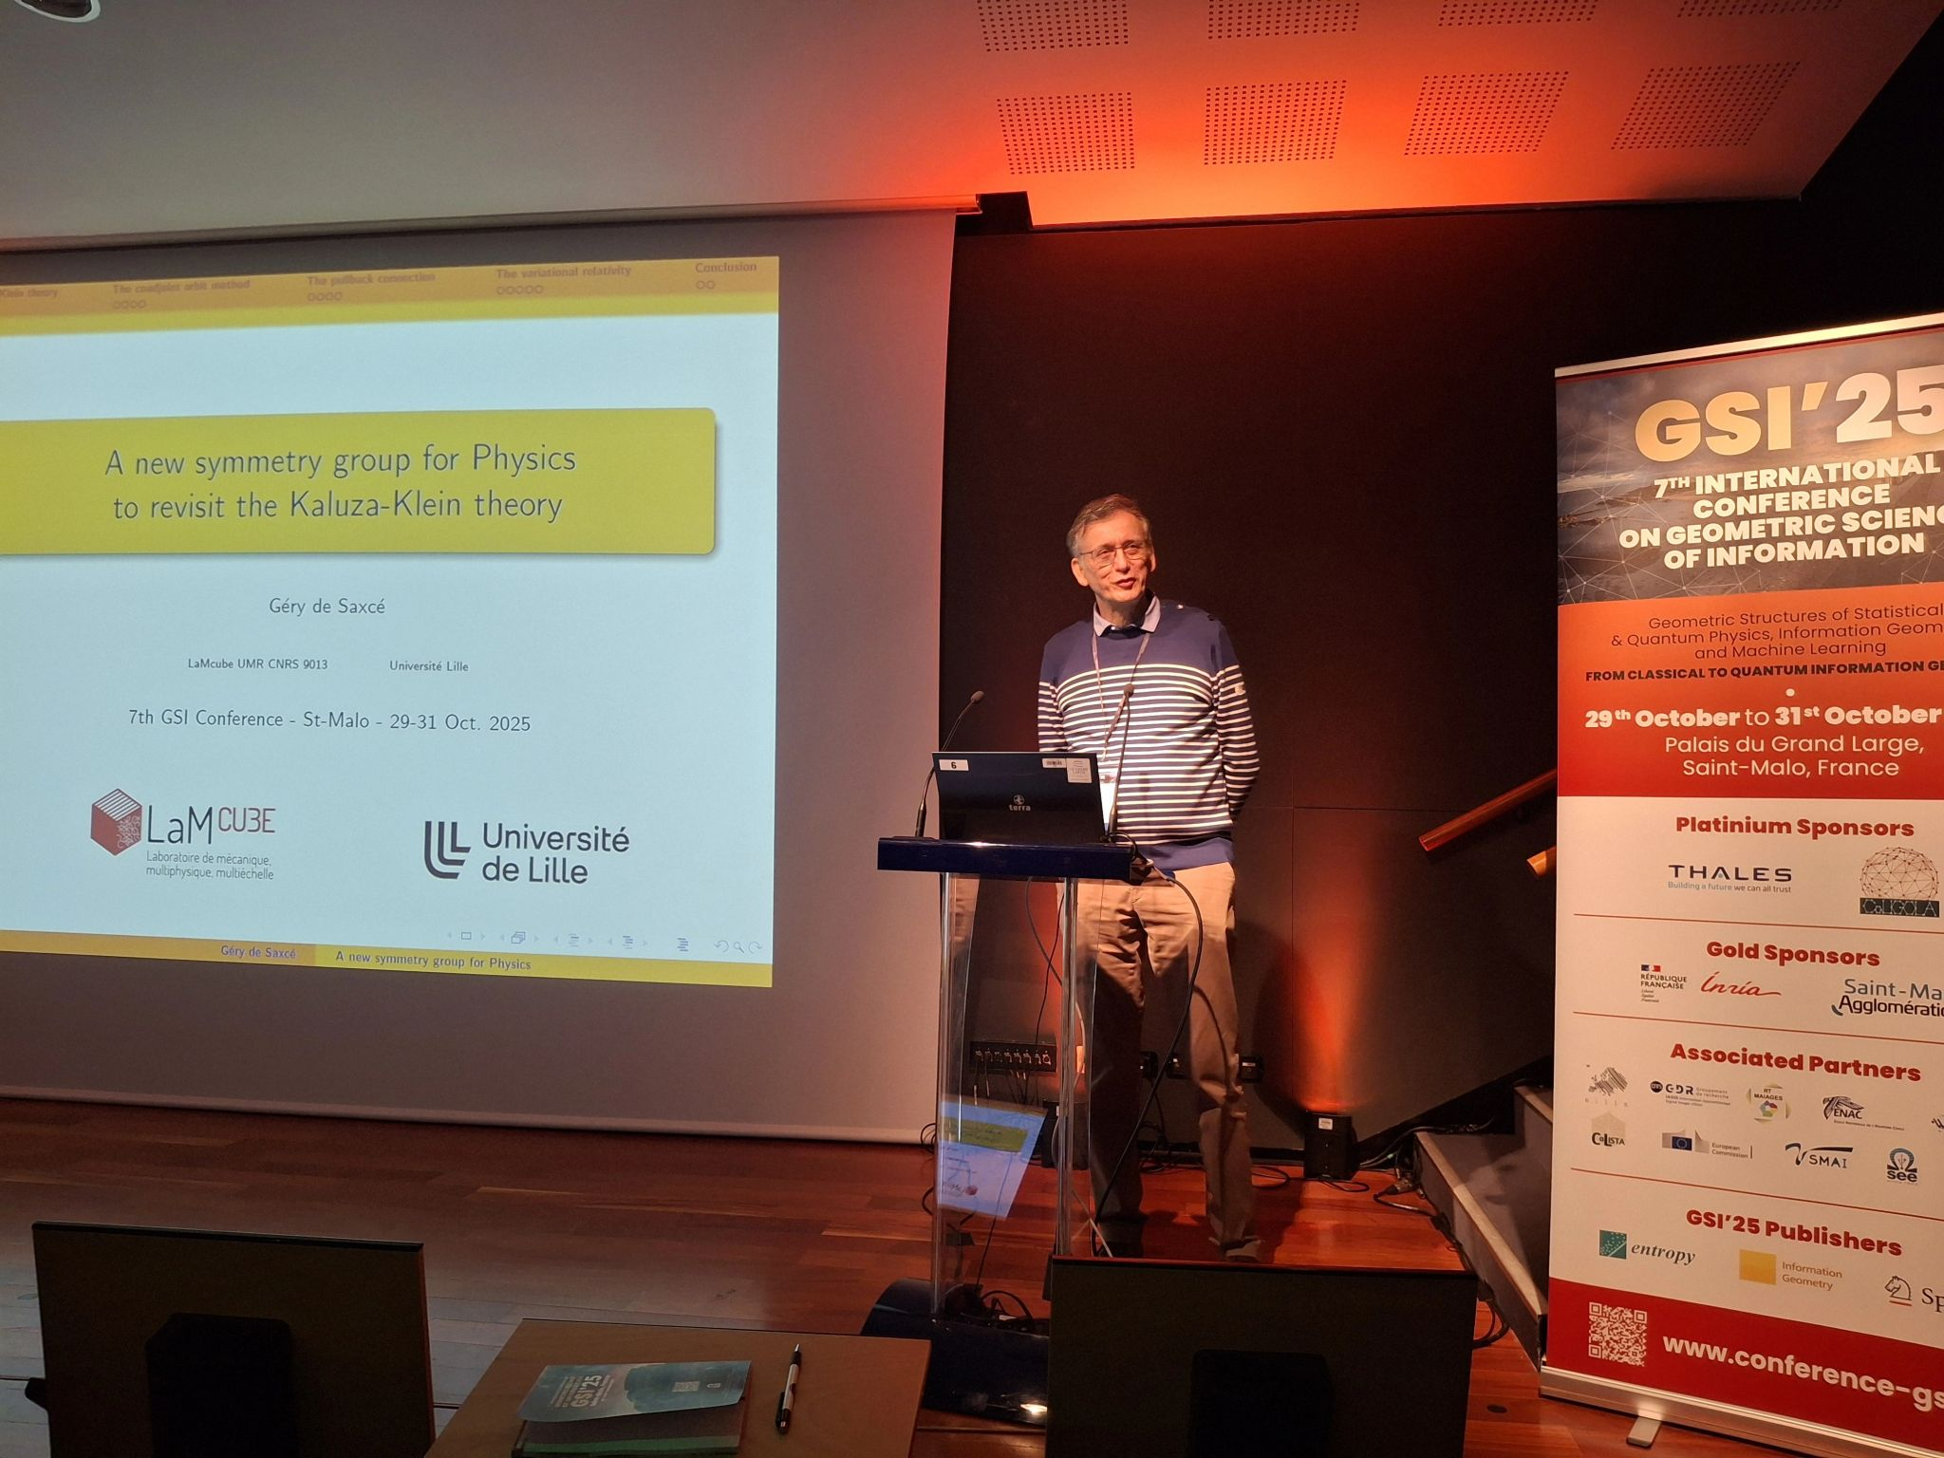

Slide 25
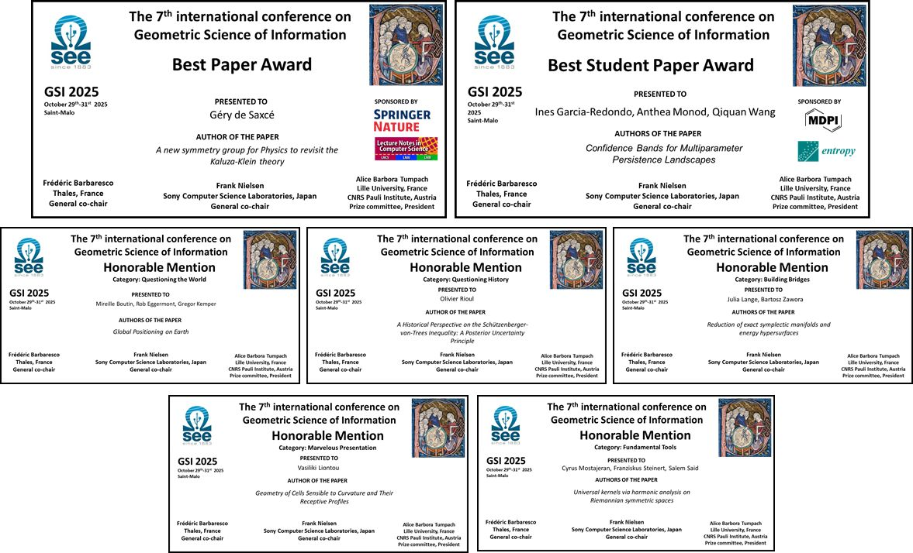

Slide 26
BEST PAPER AWARD:
"A new symmetry group for Physics to revisit the Kaluza-Klein theory“, Géry de Saxcé
BEST STUDENT PAPER AWARD:
"Confidence Bands for Multiparameter Persistence Landscapes“, Ines Garcia-Redondo, Anthea Monod, Qiquan Wang
FUNDAMENTAL TOOLS:
"Universal kernels via harmonic analysis on Riemannian symmetric spaces“, Cyrus Mostajeran, Franziskus Steinert, Salem Said
MARVELOUS PRESENTATION:
"Geometry of Cells Sensible to Curvature and Their Receptive Profiles“, Vasiliki Liontou
QUESTIONING HISTORY:
"A Historical Perspective on the Schützenberger-van Trees Inequality: A Posterior Uncertainty Principle“, Olivier Rioul
QUESTIONING THE WORLD:
"Global Positioning on Earth"
Mireille Boutin, Rob Eggermont, Gregor Kemper

Slide 27



Slide 28


Slide 29

Prize ceremony

Slide 30

Prize committee

Slide 31

Closing session
Slides: https://franknielsen.github.io/GSI/SEE-GSI'25-Closing.pdf

Slide 32







Slide 33




See you in 2027!
Photo report prepared by Frank Nielsen
with photos from various sources!
https://franknielsen.github.io/GSI/

